Slide 1
Bioinformatics in the classroom
Exploring the genome of SARS-CoV-2 using bioinformatics
https://thescienceteacher.co.uk | science thinking resources and pedagogy

Slide 2
As you work through this PowerPoint there is information, links and questions to answer.
Information
Question to answer
Click on the link

Slide 3
Welcome!

Slide 4
Science as a community
This presentation takes you through what is currently known about the genome of the coronavirus isolated from China in 2019.
We have access to this data thanks to the work of a community of scientists who are committed to making their data publicly available.

Slide 5
Before you begin…
Today you will look at data represented in something called FASTA format.
This is a text based format for representing DNA, RNA or protein sequences.
Read more about this here.

Slide 6
Do you understand FASTA format?
CAA59436.1 band 7 integral membrane MAEKRHTRDSEAQRLPDSFKDSPSKGLGPCGWI
Is this a protein or DNA sequence?
What does M represent?
What is missing from this FASTA format?
Notes:
Protein – each letter stands for an amino acid.
Methionine (amino acids are designated using a specific letter)
The ‘>’ at the start of the description line

Slide 7
Background to the coronavirus
First identified in Wuhan, the capital of China’s Hubei province
Single-stranded RNA virus
It gets its name from the petal-shaped surface projections reminiscent of the solar corona
The Wuhan coronavirus emerged from an unknown animal source

Slide 8
Model of a coronavirus
https://www.scientificanimations.com/coronavirus-symptoms-and-prevention-explained-through-medical-animation/

Slide 9
How coronaviruses get inside cells and replicate
The S protein of the coronavirus binds to surface proteins on the outside of the host cell
The virus genome now gains access to inside the cell
When inside, the single stranded RNA genome attaches to host ribosomes and gets them making virus proteins
These proteins then make more copies of the virus genome
After assembly, virus particles are transported to the cell membrane and are released going on to infect other cells
Q. What does the ‘S’ stand for in S protein and where is it located?
Source: https://www.ncbi.nlm.nih.gov/pmc/articles/PMC4369385
Notes:
Spike protein (this is a glycoprotein) and is located on the viral surface. This is crucial for viral attachment and entry to the host cell. Variation in the S protein is responsible for host range. https://www.nature.com/articles/7290240

Slide 10
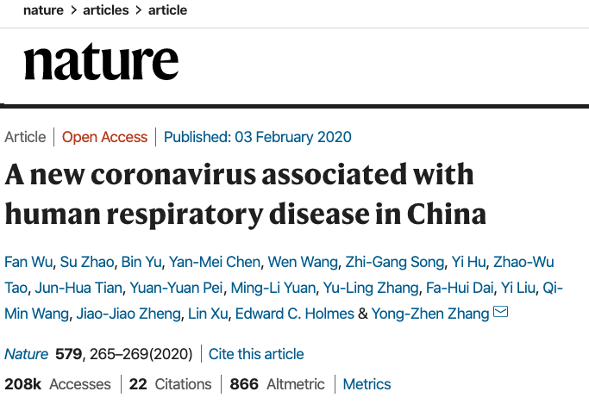
The first paper reporting the SARS-Cov-2 genome
Read the abstract of the paper and answer the following questions:
How many authors contributed to this work?
What journal was the scientific paper published in?
What are you told about the patient?
Which organ was the virus isolated from?
What name was the virus given and what family was it found to belong to?
What is the evidence that bats may be a host for SARS-Cov-2
Notes:
19
Nature
Patient was a worker at the market and admitted to Central Hospital of Wuhan on 26 December 2019 with fever, dizziness and a cough.
From the lungs
‘WH-Human 1’ coronavirus and belongs to the Coronaviridae, family
SARS-Cov-2 is most closely related to a group of viruses that had previously been isolated from bats in China

Slide 11
Naming of the virus
Read the following page from the World Heath Organisation.
Explain the difference between COVID-19, SARS-CoV-2 and coronavirus
Notes:
SARS-CoV-2 is the name of the virus
COVID-19 is the name of the disease that the virus causes
Coronavirus is a family of viruses

Slide 12
The genome of SARS-CoV-2
The 30 kilobase genome of the Wuhan seafood market strain is publicly available
You are now going to explore its genome today
Go to the NCBI GenBank page to look at this sequence and answer the questions from the next slide

Slide 13
Questions about the genome
How long is the viral genome?
What organism was this virus isolated from?
Find the S gene that codes for the S protein. What are the nucleotide positions that this gene is located in?
For comparison, how long is a) the human genome and b) the E.coli genome?
Notes:
29903 bp
Homo sapiens (humans) – this is the same sequence that came from the paper on slide 10
From 21563..25384
Human: 3,099,706,404 (https://www.ncbi.nlm.nih.gov/assembly/GCF_000001405.39)
E coli 5,594,605 (https://www.ncbi.nlm.nih.gov/assembly/GCF_000008865.2)

Slide 14
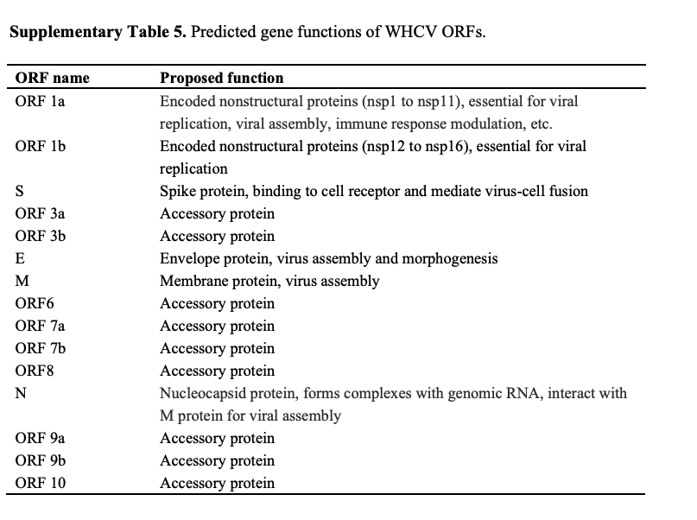
Proteins of the virus
Source

Slide 15
How similar is this virus to other viruses?
To find out you will search the GenBank database using a program called BLAST. It’s a bit like Google but for biological sequences.
Step 1. Copy the complete genome sequence of the Wuhan isolate in FASTA format
Step 2. Paste this into the BLAST query sequence box
Step 3. Press BLAST and wait for results to show

Slide 16
Reviewing your results
Look at the results – or matches. These list other sequences in the database that are similar to the sequence you searched with. Take some time to explore this page.
Which other countries have sequenced SARS-CoV-2 genomes that match the Wuhan isolate?
Find a match that is less than 81 % identical. Which host did this virus come from?
Notes:
At the moment I can see China, US, Japan (this list will change as more countries submit sequences)
Bats

Slide 17
Reflections
How has your understanding of SARS-CoV-2 changed as a result of this session?
How has your understanding of bioinformatics changed as a result of this session?

Slide 18
Assignment
Using the tools and information you have learnt about in this session:
1. Explore the genome of human immunodeficiency virus (GenBank page)
2. Compare and contrast SARS-CoV-2 with Human immunodeficiency virus (GenBank page)

