Slide 1
Topic | Drawing particle pictures for solids, liquids and gases | Level | Key Stage 3 (or any course for students aged 11-14)
Outcomes | Draw accurate particle pictures for solids, liquids and gases Draw particle pictures for solids, liquids and gases being poured Accurately peer assess particle pictures and give specific feedback
Information for teachers | This assessment activity provides an opportunity for students to practice drawing particle pictures for solids, liquids and gases and receive some feedback from their peers. They then have the opportunity to use this feedback when they complete slide seven. I think it is helpful to ask students to draw these pictures inside a beaker as opposed to just a box so they can better relate the diagrams to the substance – you can set up three beakers on your desk containing: liquid water, ice cube and air. Remind students that the beaker and surrounding air are also made from particles, just these are not shown here. To check that students really understand how the particle model explains the properties of solids, liquids and gases, ask students to draw each state of matter being poured out of a beaker (slide seven).
Other resources | Other resources on particles are here: http://thescienceteacher.co.uk/particle-pictures/
www.thescienceteacher.co.uk | resources for science teachers who like to think

Slide 2
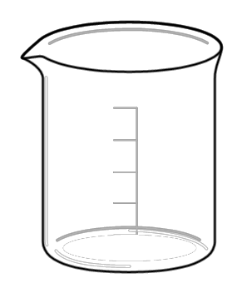
Draw a particle picture for a solid, liquid and gas
SOLID
LIQUID
GAS

Slide 3
Peer assessment: Solids
All particles are the same size
All particles are touching
Particles are arranged in ordered layers
The substance has a fixed shape

Slide 4
Peer assessment: Liquids
All particles are the same size
All particles are touching at least one other particle
Particles are randomly arranged
The substance does not have a fixed shape

Slide 5
Peer assessment: Gases
All particles are the same size
No particles are touching each other (distance between them is about 10 x diameter of each particle)
Particles have arrows to show movement
The substance does not have a fixed shape

Slide 6
Before you hand back the work
Write your feedback under each picture and include:
What was good about each picture?
example: all particles were the same size
What could be improved about each picture (be specific)
example: all particles should touch in a solid
Now pass your feedback to your partner and correct your particle pictures.

Slide 7
Imagine the substance is now poured out of the beakers onto the table. What would your particle pictures now look like?
SOLID
LIQUID
GAS

