Slide 1
Topic | Function of the kidney - journey of a water molecule through the body | Level | GCSE (or any course for students aged 14-16)
Outcomes | To describe the journey of a water molecule as it passes from the mouth to the blood, to the kidney, to the bladder and out through the penis.
Information for teachers | Ask students to describe the journey of a water molecule from the mouth to the urinal. They must sketch, label and annotate each major organ involved. Print off slide 2 in A3 and get students to work in pairs or individually (alternatively, they could copy this). This activity should only be done when students have been introduced to the human kidney, circulatory system and digestion. While students are completing the diagram you can walk around the class and provide feedback. This is a challenging activity so you may want to model the first few steps. Provide students with key terms that are appropriate to your course e.g. large intestine, urethra, artery, oesophagus, filter, kidney tubules, renal artery, bladder and ureter. Warning!! Students could get silly when drawing the male anatomy so adapt/warn for your class as necessary… Good luck!
www.thescienceteacher.co.uk | resources for science teachers who like to think

Slide 2
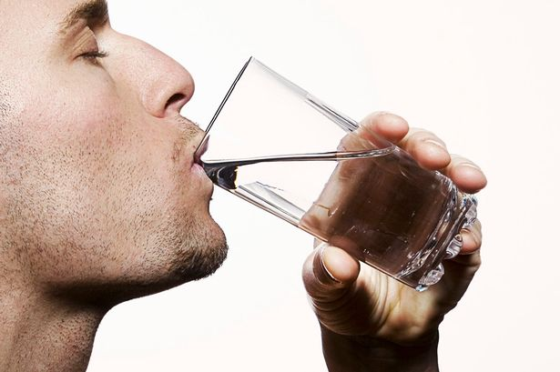
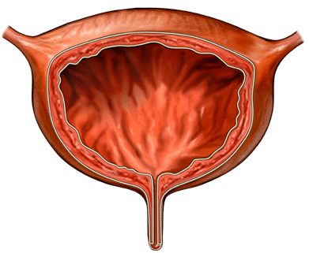
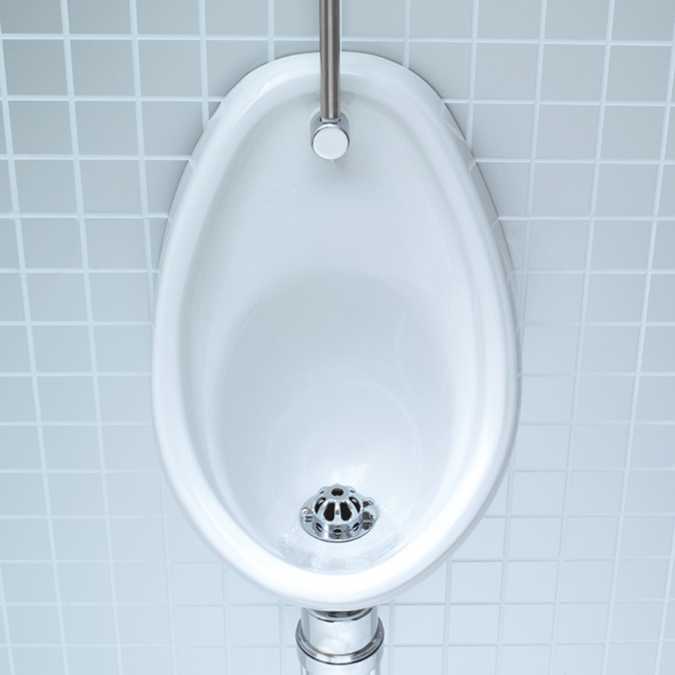
H₂O
H₂O
Water is present in urine that is stored in the bladder.
Not to scale

