Slide 1
Topic | Surface area to volume ratio | Level | GCSE (or any course for students aged 11-16)
Outcomes | To calculate the surface area to volume ratio for a variety of cubes To understand why unicellular organisms can exchange materials without complex gas exchange systems
Information for teachers | Use this thinking task to introduce the concept of surface area to volume ratio. Make sure students are comfortable with expressing quantities as ratios first e.g. ¼ = 1:3 . Then move on to calculate the surface area to volume ratios for various cubes of different sizes. Model the first example and allow students to then complete the rest. Peer assess answers whilst wandering around the classroom to check understanding.
www.thescienceteacher.co.uk | resources for science teachers who like to think

Slide 2
How could you increase the surface area of this cube?

Slide 3
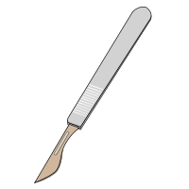
We could cut it in half.
Notes:
OK, so it is no longer a cube but you get the idea! You could melt it too!

Slide 4
Cube side length (cm) | Total surface area of cube (cm²) | Total volume of cube (cm³) | Surface area: volume ratio
1 | 6 | 1 | 6:1
2
3
4
5
1cm
Describe how surface area to volume ratio changes as cubes increase in size?
Use information in this table to explain why bacteria don’t have lungs.
Give one disadvantage to a cell of having a large surface area to volume ratio?

Slide 5
Cube side length (cm) | Total surface area of cube (cm²) | Total volume of cube (cm³) | Surface area: volume ratio
1 | 6 | 1 | 6:1 (6)
2 | 24 | 8 | 3:1 (3)
3 | 54 | 27 | 2:1 (2)
4 | 96 | 64 | 1.5:1 (1.5)
5 | 150 | 125 | 1.2:1 (1.2)
1cm
Describe how surface area to volume ratio changes as cubes increase in size? As the size of the cube increases the surface area to volume ratio decreases.
Use information in this table to explain why bacteria don’t have lungs. Bacteria are very small, and so have a large surface area to volume ratio. This allows nutrients and gases to exchange rapidly into the cell and therefore they don’t require lungs.
Give one disadvantage to a cell of having a large surface area to volume ratio? Rapid water loss.

Slide 6
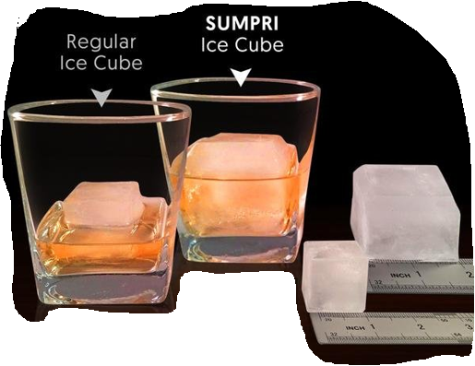
Going deeper
Use your knowledge of surface area to volume ratio to suggest which ice cube is better.
Consider both the cooling effect and drink dilution.
Notes:
Source: http://sumpri.com/blog/

Slide 7
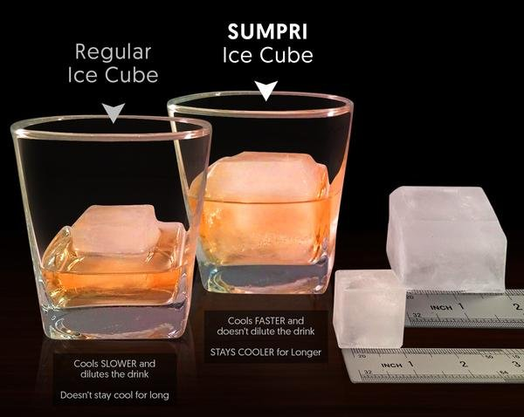
Going deeper
The Sumpri ice cube is best because it has a smaller surface area to volume ratio.
The volume of the ice provides the cooling effect but the surface area controls how fast the ice melts – the lower the surface area to volume ratio the longer the ice will take to melt for the same cooling effect. Essentially, a lower surface area to volume ratio keeps your drink cold, but stops it from becoming too diluted. (source)
Notes:
Source: http://sumpri.com/blog/

