Slide 1
Topic | Distillation | Level | Key Stage 3 (or any course for students aged 11-16)
Outcomes | To explain how distillation can be used to separate a mixture involving liquids with different boiling points To describe how filtration can be used to separate a solid from a solution
Information for teachers | Making Ribena is a great context to teach distillation. It’s sufficiently simple to be useful, and students will want to know how this delicious drink is made. I’ve simplified the process somewhat to focus the context on the key concepts we want students to learn. You could adapt this resource if looking at fractional distillation, as this would also work, and perhaps be a better way of separating out the two liquids. However, for this activity, we will assume that the water and the smell particles have a large enough difference in boiling point to be separated by simple distillation.
www.thescienceteacher.co.uk | resources for science teachers who like to think

Slide 2
Making Ribena
Ribena is a drink made from blackcurrants. The
blackcurrants are harvested from farms across the UK
and taken to factories. The blackcurrants are squashed
between giant plates and the juice from the ‘squash’ is
separated from the berry skins. Before the
blackcurrant juice is stored, some of
the water is removed.
Unfortunately, during this process, some of the
particles that give the juice a blackcurrant smell also
evaporate. Distillation is used to collect these ‘smell particles’
which are then stored in big tanks. The blackcurrant concentrate
and the smell particles are mixed together when the Ribena is
put into bottles.

Slide 3
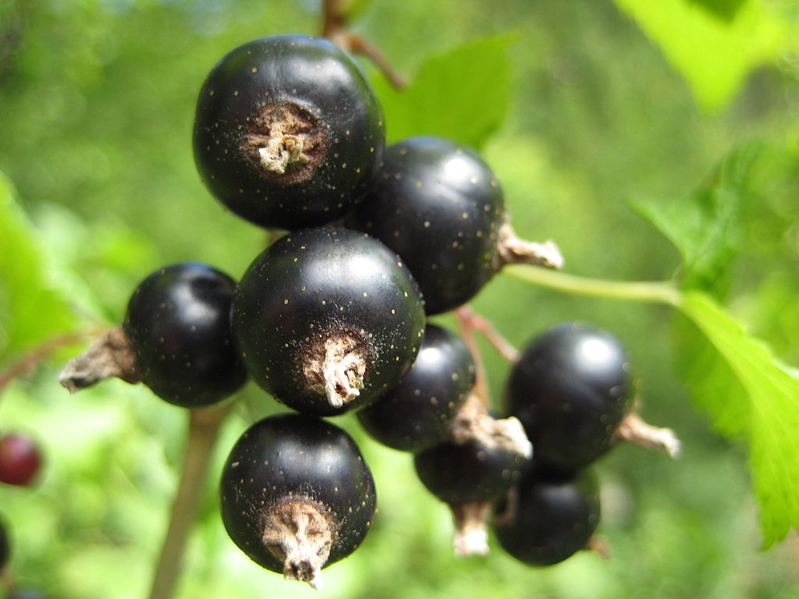
Boiling point
Answer the following questions after you have read about making Ribena.
What separation process do you think was used to separate the blackcurrant juice from the blackcurrant skins? (line 5)
Suggest why water is removed from the juice. (line 7)
Why can’t the water just be removed by evaporation?
Would simple distillation collect the smell particles if their boiling point was 100 ºC? Explain your answer.
Write a method to explain how you would make Ribena concentrate in the lab. You should include how you would:
i) release the juice from the blackcurrant berries
ii) separate the blackcurrant juice from the blackcurrant skin
iii) remove the water particles
iv) but still collect the smell particles
v) create your final Ribena drink.
150ºC
100ºC
(Water)
50ºC
(Smell)
0ºC
Blackcurrant
-50ºC

Slide 4
Boiling point
What separation process do you think was used to separate the blackcurrant juice from the blackcurrant skins? (line 5)
Filtration.
2. Suggest why water is removed from the juice. (line 7)
So it takes up less volume to store/requires fewer storage tanks/ fewer lorries to transport?
Why can’t the water just be removed by evaporation?
Because the smell particles would also evaporate and be lost
4. Would simple distillation collect the smell particles if their boiling point was 100 ºC? Explain your answer.
No, because they would evaporate and condense with the water particles.
5. Write a method to explain how you would make Ribena concentrate in the lab. You should include how you would:
i) release the juice from the blackcurrant berries (crush using pestle and mortar)
ii) separate the blackcurrant juice from the blackcurrant skin (filter)
iii) remove the water particles (heat)
iv) but still collect the smell particles (must collect first, heating to b.pt and condense, then remove distillate)
v) create your final Ribena drink (add back smell particles to concentrate, add water and some sugar!)
150ºC
100ºC
(Water)
50ºC
(Smell)
0ºC
-50ºC

