Slide 1
Topic | Transpiration | Level | GCSE (or any course for students aged 11-16)
Outcomes | Be able to label the structure of a typical leaf Describe and understand the role of stomata and the waxy cuticle in transpiration
Information for teachers | Make sure students are first happy with the structure of a typical leaf using slide 2. Then challenge students to predict which leaves (A-D) will lose the most water. This can then lead to a more detailed explanation of transpiration and factors that affect it. Further reading on cuticles here and their effect on transpiration.
www.thescienceteacher.co.uk | resources for science teachers who like to think

Slide 2
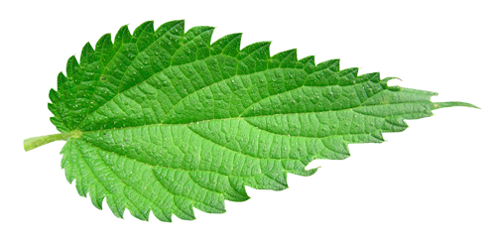
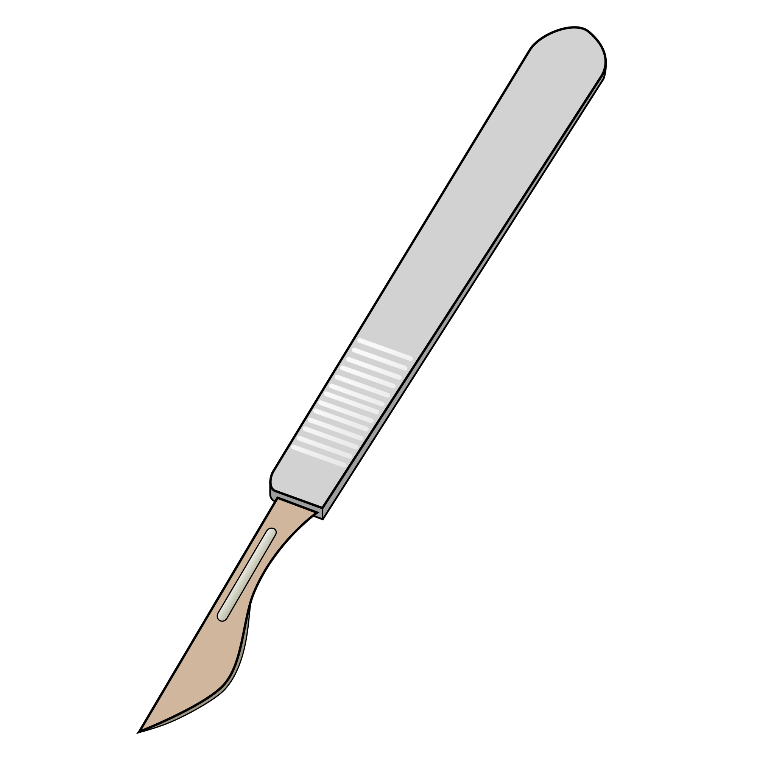
Label this diagram of a leaf by completing the table below.
A
B
C
D
E
F
G
I
H
K
J
Letter | Tissue | Letter | Structure
B |  | A
C |  | E
D |  | I
F |  | J
G |  | K
H

Slide 3
Which leaf will lose the most water? Arrange the leaves in order of increasing water loss. Start with the leaf that you think will lose the least water. Justify your choice.
You can assume the concentration of water vapour outside each leaf is the same.
Leaf A
Leaf C
H₂O(g)
Leaf B
Leaf D
=

Slide 4
Answers
Leaf A – thick waxy cuticle and only one stoma on the underside of the leaf so water loss is minimal
Leaf C – thinner waxy cuticle on upper epidermis so will lose more water than A. But, still only one stoma on the underside of the leaf so less water lost than D
water loss
Leaf D –two stomata on the underside of the leaf so more water loss than C that only has one stoma
Leaf B –two stomata but one is on the upper side of the leaf so will lose more water than the stomata in leaf D which are both on the leaf underside

