Slide 1
Topic | What is a wave? | Level | For students aged 11-16
Outcomes | Students understand the key elements of a wave to include: amplitude, frequency, wavelength, disturbance and energy transfer
Teaching points | For many students using surf waves to understand physics waves can be confusing. Waves in the ocean appear to involve the movement of matter. I think ripples make a better context to help students understand that a wave is a disturbance that travels through a medium, transporting energy from one location to another. In order to have a disturbance there must also be a rest (or equilibrium) position. Once disturbed, the particle will return to its rest position and therefore a wave transfers energy and not matter.
www.thescienceteacher.co.uk | resources for science teachers who like to think

Slide 2
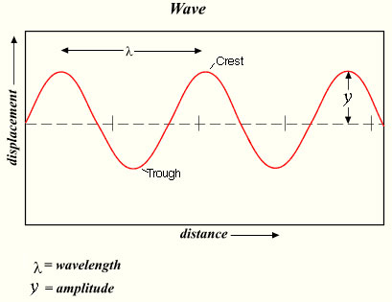
Label the equilibrium position

Slide 3
Understanding waves
A pebble was thrown into a pond to create a ripple.
A. On the ripple image label:
A peak
A trough
An amplitude
A wavelength
The direction of energy transfer
B. Questions to think about
What created the ripple in the first place? Think about what the pebble did to the water particles.
If a larger pebble was thrown into the water, how would the ripple be different? Consider changes to the wavelength, amplitude and frequency.
A leaf is floating on the surface of the water. What will happen to its movement? Explain.

Slide 4
How are they similar and different?
Click on the links
Water ripple
Mexican wave
Key ideas to use: disturbance, energy, wavelength, medium, equilibrium, frequency

