Slide 1
Topic | Properties of light | Level | Key Stage 3 (or any course for students aged 11-14)
Outcomes | Students understand the difference between luminous and non-luminous objects Students can draw a simple ray diagram to show how we can see luminous and non-luminous objects Students can describe what happens to light when it hits an opaque, translucent and transparent material.
Information for teachers | This activity provides a simple model of progression to introduce students to the main properties of light. This would work well for the first lesson on light in Yr7 or Yr8.
www.thescienceteacher.co.uk | resources for science teachers who like to think

Slide 2
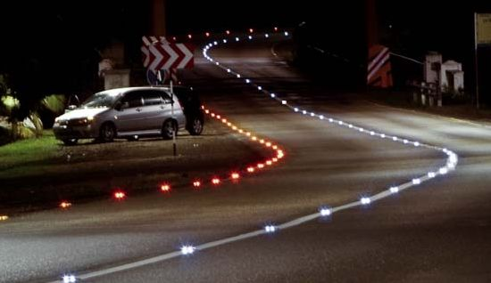
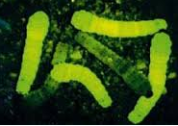
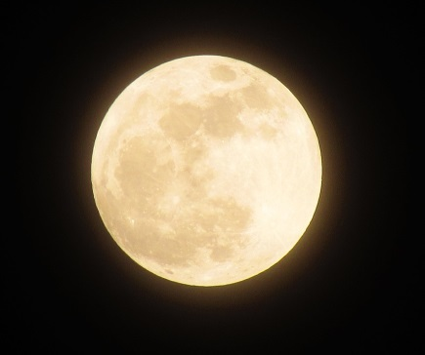
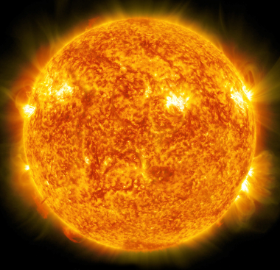
glow worms
cat’s eyes
lit candle
fluorescent jacket
the moon
a bulb
Put these objects into two groups and explain you reasoning for each object.
candle
the sun
an apple

Slide 3
luminous
non-luminous

Slide 4
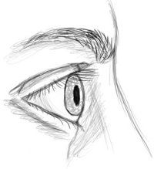
So how can we see luminous and non-luminous objects?
Draw a diagram to show how Rob can see (i) the light and (ii) the apple.
Rob

Slide 5
Light and materials
Material | Use the key to identify if the material is transparent, translucent or opaque
Cardboard
Frosted glass
Glass
Green filter
Can light pass through the material?
Can you see clearly through the material?
The material is transparent
The material is translucent
The material is opaque
Yes
No
Yes
No

Slide 6
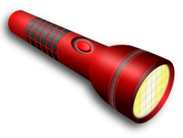
Type of material | Ray diagram to show what happens to the light when it meets a transparent, translucent and opaque material
Transparent
Translucent
Opaque

Slide 7
opaque
transparent
Room 1
Room 3
luminous object
non-luminous object
transparent
transparent
Room 2
Room 4
non-luminous object
luminous object
In which room(s) will the person be able to see the object?

