Slide 1
Topic | Pressure in liquids and gases | Level | GCSE (or any course for students aged 11-16)
Outcomes | To describe and explain the changes in atmospheric pressure To use the particle model to explain changes in pressure in both liquids and gases Explain how pressure changes with depth in liquids Covert between Pa and kPa This resource was contributed by Terry Baylis
Instructions for teachers: this activity requires students to have an understanding of the particle model for solids, liquids and gases. Students then use these ideas to explain pressure in liquids and gases.
www.thescienceteacher.co.uk | resources for science teachers who like to think

Slide 2
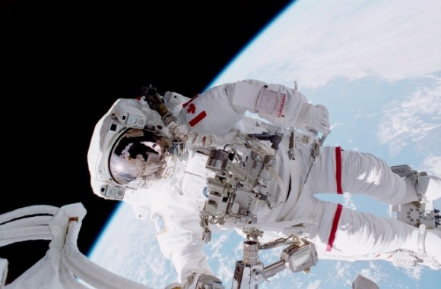
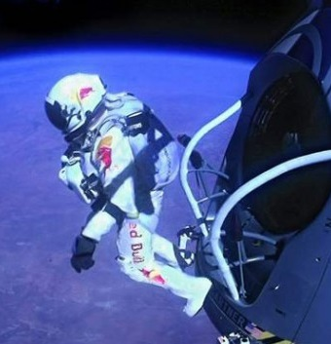
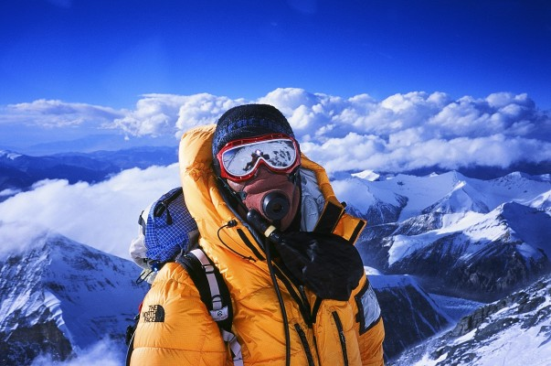
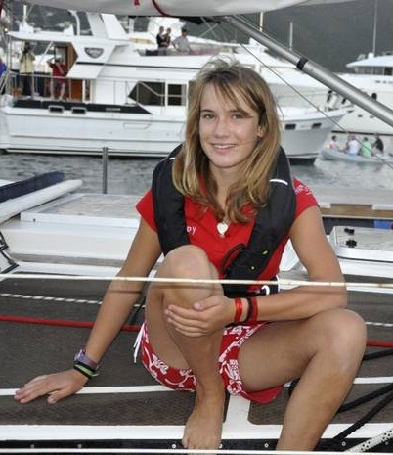
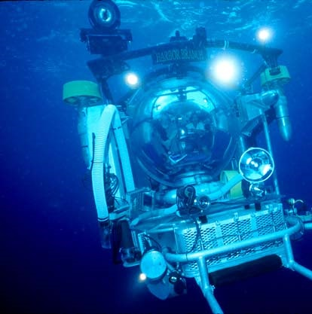
Who is under the most pressure?
Notes:
10 minutes think pair share

Slide 3
I’m an astronaut working on a repair to the international space station. I am 370 km from the Earth’s surface!

Slide 4
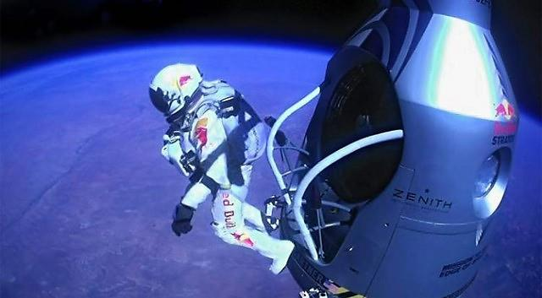
I’m Felix Baumgartner and I am jumping 39 km to the Earth from the edge of space!

Slide 5
I have just conquered Everest! I am 8.8 km above sea level.

Slide 6
I’m the youngest person ever to sail around the world!

Slide 7
I’m a scientist exploring the deepest oceans at 11 km under water!

Slide 8
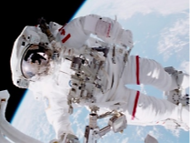
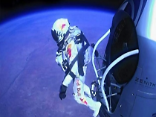
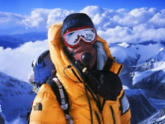
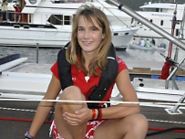
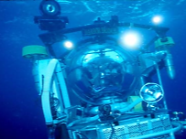
International Space Station
- 370 km
Particle diagram
Q7: What would happen to an astronaut if it wasn’t for their space suit? Explain your answer.
Q6: Approximately what pressure should it be inside a space suit? Explain your answer.
Particle diagram
Q5: The further Felix fell, the more his rate of acceleration reduced. Why?
Particle diagram
Q4: How would you calculate the density of air if you had a beaker, a balloon, some water and a balance?
(Approximate scale)
Particle diagram
Q3: At sea level, atmospheric pressure is 101,325 Pa. What is the pressure in kPa?
Felix Baumgartner Jump
- 39 km
Q2: What would happen to a deep-sea diver if they didn’t have a special pressurised submersible? Explain your answer.
Q1: Why doesn’t the density of water increase even at high pressures?
Particle diagram
Mount Everest - 8.8 km
Sea Level – 0 km
Deepest Ocean – -11 km

