Slide 1
Topic | Evolution: decent with modification | Level | For students aged 14-16
Outcomes | To understand the concept of a common ancestor To use data to consider the evidence for evolution – decent from a common ancestor with modification To use evidence (data) to support a claim
For this lesson you will need to print out slides 7-11 for the group discussion. More information on argumentation is available here:
http://thescienceteacher.co.uk/argumentation-in-science/
www.thescienceteacher.co.uk | resources for science teachers who like to think

Slide 2
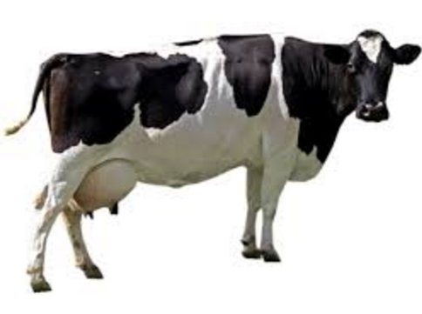
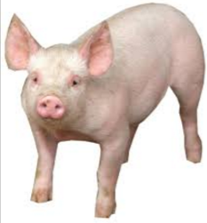
What do you think the common ancestor looked like?
Draw what you think the common ancestor could have looked like?!
Notes:
Think about shared features. The common ancestor would not be half pig, half cow as some students would think.

Slide 3
Who is more closely related to C? A or B?
A
C
B
Notes:
B.

Slide 4
Who is more closely related to A? C or B?
A
C
B
Notes:
C and B are equally related to A.

Slide 5
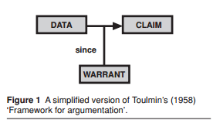
Argumentation in science
To make an argument claims are justified by relating them to the data on which they are based.
Evidence for any claim consists of at least two components – data and warrants. Warrants are essentially the means by which the data are related to claims providing the justification for belief.

Slide 6
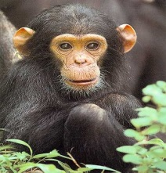
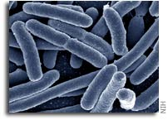
Theory 1
Theory 2
Each organism is unrelated and is created independently
Life evolved many times
All life shares common ancestry - all life is related
Life evolved once only

Slide 7
Theory 1: All living organisms evolved from a single common ancestor.
Theory 2: Life evolved many times independently.
Discuss whether the pieces of evidence (data) in front of you support Theory 1, Theory 2, both or neither.

Slide 8
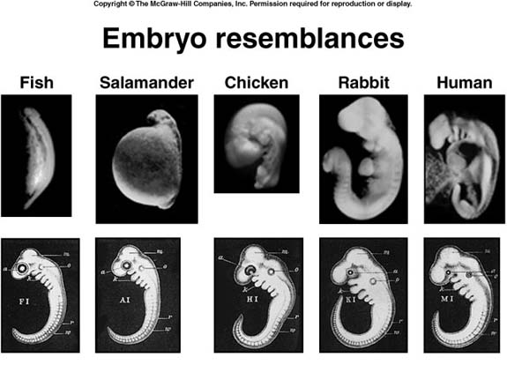
Comparison of embryos
Data 1

Slide 9
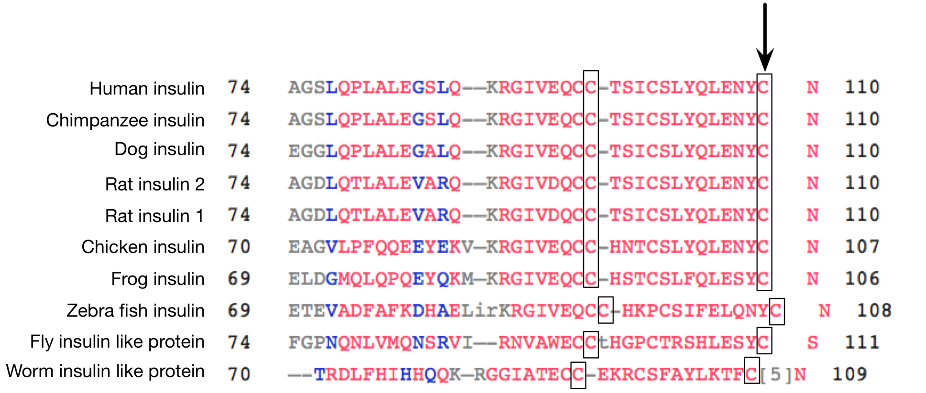
Comparison of protein sequences
Data 2

Slide 10
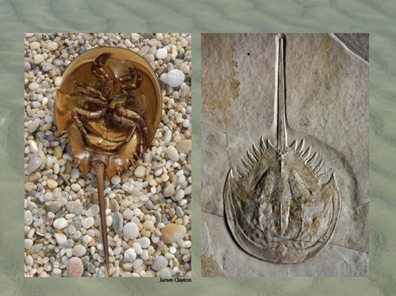
The horseshoe crab – a present day example and a fossil from 500 million years ago
Data 3
Notes:
http://horseshoe-crabs.com/the-horseshoe-crab-a-living-fossil/

Slide 11
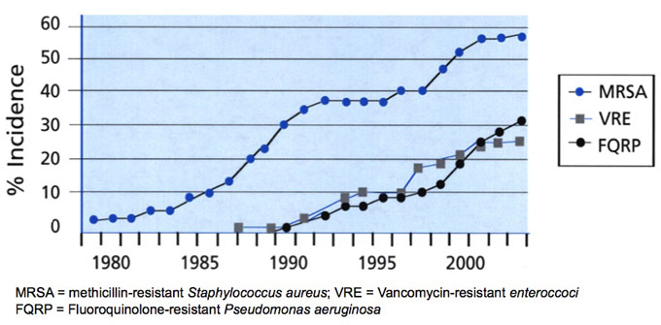
An increase in antibiotic resistant bacteria
Data 4

Slide 12
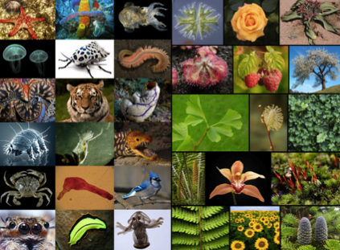
The diversity of life
Data 5

Slide 13
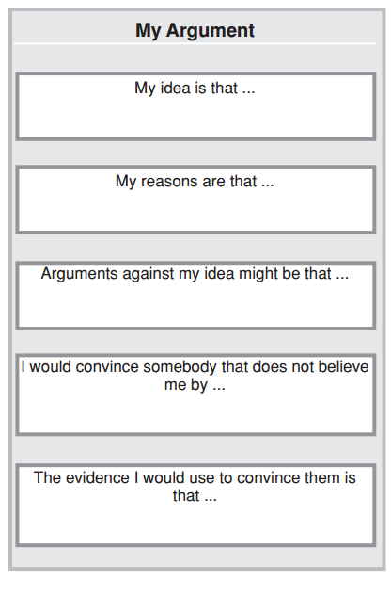
Theory 1: All living organisms evolved from a single common ancestor.
Theory 2: Life evolved many times independently.
(writing frame taken from:
Osborne, J., Erduran, S., and Simon, S. “Enhancing the quality of argumentation in school science.” Journal of research in science teaching 41.10 (2004): 994-1020.)

