Slide 1
Topic | Uses for glucose made by photosynthesis | Level | Key Stage 3 (or any other course for students aged 11-14)
Outcomes | To understand why plants photosynthesise To describe uses for glucose by a plant
www.thescienceteacher.co.uk | resources for science teachers who like to think

Slide 2
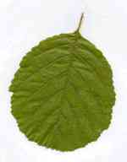
Glucose
Can be used by the plant to …………

Slide 3
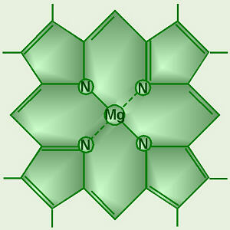
Glucose
Stored as starch
Used to make protein e.g. chlorophyll
Used for respiration
Converted into cellulose

Slide 4
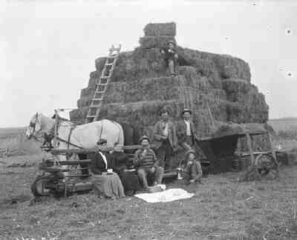
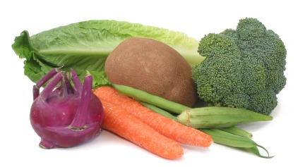
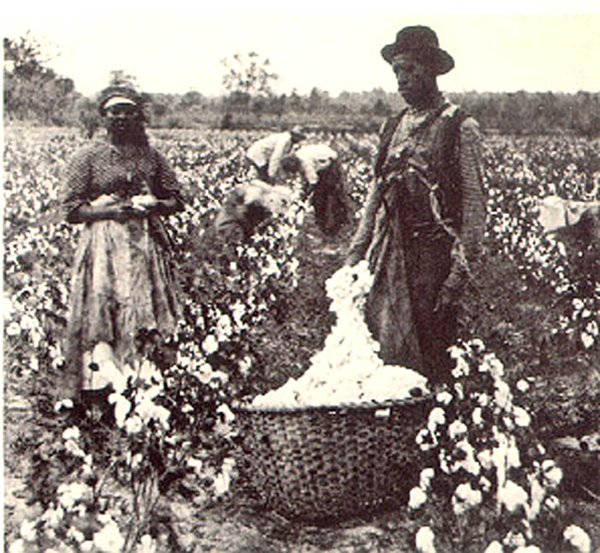
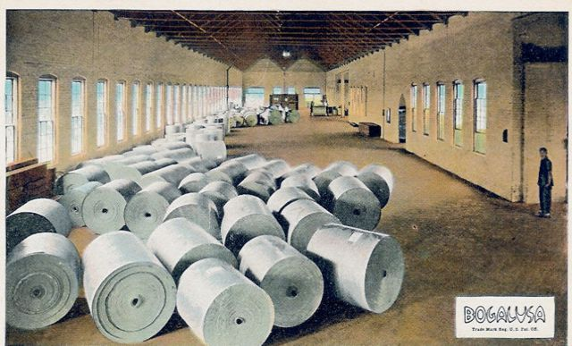
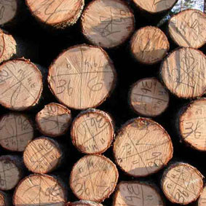
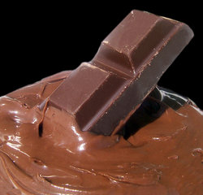
Look at these pictures, imagine a world without plants. Write a paragraph describing how your life would be different without plants.

