Slide 1
Topic | Conservation of mass | Level | Key Stage 3 (or any course for students aged 11-14)
Outcomes | Students understand the concept of conservation of mass Students can explain why the mass of products and reactants may not always stay the same when chemical reactions involve gases
Information for teachers | This activity has been designed to get students thinking about conservation of mass. It would be ideal for 11 year olds when they first study chemical reactions. The next step could be to write balanced equations. You will need to demonstrate the reactions in slides 2 and 3.
www.thescienceteacher.co.uk | resources for science teachers who like to think

Slide 2
Let’s get thinking
When 5 grams of copper sulphate solution is added to 5 grams of sodium hydroxide solution, solid copper hydroxide and sodium sulphate solution are formed.
Which statement(s) are correct? Discuss in your pairs.
The products will have a greater mass than the reactants because a solid is made.
The products and the reactants will have the same mass as they contain the same number of atoms. The atoms are just arranged differently.
The products will weigh less than the reactants because some of the reactants have been used up in the reaction.
solid copper hydroxide and
sodium sulphate solution
copper sulphate solution
sodium hydroxide solution
+
5.0 g
5.0 g
? g
Notes:
Purpose: to engage and create a reason for learning - link real world to scientific ideas
Ideas:
Demonstrations e.g. elephant’s toothpaste
A big question e.g. where do the stars go at night? Students can then return to this big question at the end of the lesson
Current news story
Video clip
Discrepant observations through cognitive conflict e.g. hammer and feather on a vacuum, ice melting faster on a 'cold' surface
Interesting facts e.g. there are more bacteria in you than human cells. Or, how many bacteria are there after 24 hours if you start with one.
What would happen if...

Slide 3
Uh oh….. is the law wrong?
Reaction to demonstrate to the class | Word equation | Mass of reactants (g) | Mass of products (g) | Did the reactants and products have the same mass? If not, why not?!
Calcium carbonate with hydrochloric acid
Burning magnesium in oxygen
Notes:
Purpose: to practice using the new knowledge and skills from the introduce episode
Ideas:
Practice questions
Unpicking mistakes in exam questions
Practical investigations to observe and explore scientific ideas and practice performing skills
Role play
Making models
Answering questions about the introduce episode
Comprehension exercise

Slide 4
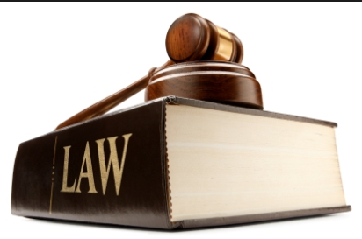
Dear Scientists, I have made an Earth shattering discovery!! When I added hydrochloric acid to a beaker of calcium carbonate the mass decreased. I have proved the law of conservation of mass wrong!! Yours truly, Dr Wrong Again.
Write a letter to Doctor Wrong explaining why he is wrong.
Use your knowledge of chemical reactions to persuade him. Include chemical reactions and particle pictures.
What changes could Dr Wrong Again make to his experiment to reach the right conclusion? How could you convince Dr Wrong Again that a gas has a mass?
Notes:
Purpose: to practice using the new knowledge and skills from the introduce episode
Ideas:
Practice questions
Unpicking mistakes in exam questions
Practical investigations to observe and explore scientific ideas and practice performing skills
Role play
Making models
Answering questions about the introduce episode
Comprehension exercise

