Slide 1
Topic | Air resistance | Level | Key Stage 3 and GCSE
Outcomes | To be able to describe and explain air resistance To evaluate a model for air resistance To describe and explain how we can reduce air resistance
www.thescienceteacher.co.uk | resources for science teachers who like to think

Slide 2
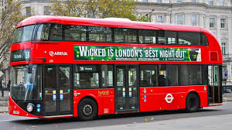
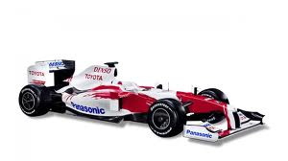
What changes could we make to the bus to make it travel as fast as the car?
Top speed: 90 mph
Top speed: 233 mph
Notes:
Students have to work in pairs to come up with as many ways as they can to redesign the bus so that it would travel at the same speed as the car. We are trying to illicit the concept of aerodynamics and air resistance – even if students do not actually use this word

Slide 3
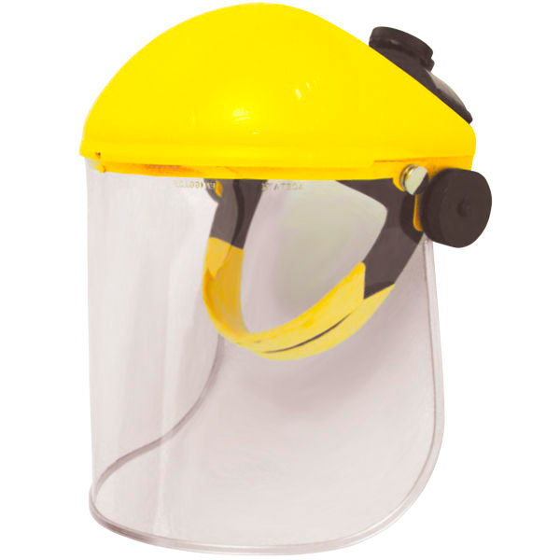
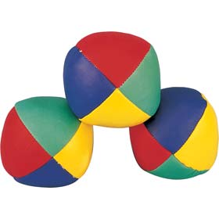
Modelling air resistance: feeling the force
SAFETY SCREEN
Notes:
Depending on the students in your class you may trust them to hold the safety screen and throw the balls.

Slide 4
Our model
In our model what did the ping pong ball and safety screen represent?
Describe what happened when the ping pong balls were thrown against the screen. What did you observe? What did you hear?
Did the juggling balls behave in the same way as the ping pong balls? Which ball do you think is the best representation of an air particle? Explain your answer.
If the safety screen moves faster towards the balls what happens to (i) the force of the impact and (ii) frequency of impact
How could we adapt this model to show why a formula one car experiences less air resistance than a bus?
In this model the ‘car’ is not moving very fast. What other problems (limitations) are there with this model.
Did you find this model useful to help understand air resistance. Why? Why not?
In your own words can you now explain why a one formula car travelling at 50 mph experiences less air resistance than a bus travelling at the same speed?
Challenge! Could a formula one car ever experience more air resistance than a bus? Explain.

