Slide 1
Topic | Fractional distillation of crude oil | Level | GCSE
Outcomes | To understand the process of fractional distillation To understand the terms viscous, fraction and volatile
www.thescienceteacher.co.uk | resources for science teachers who like to think

Slide 2
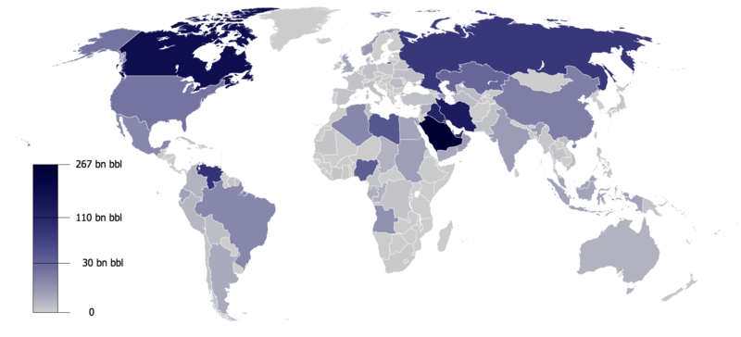
What do the various colours represent?

Slide 3
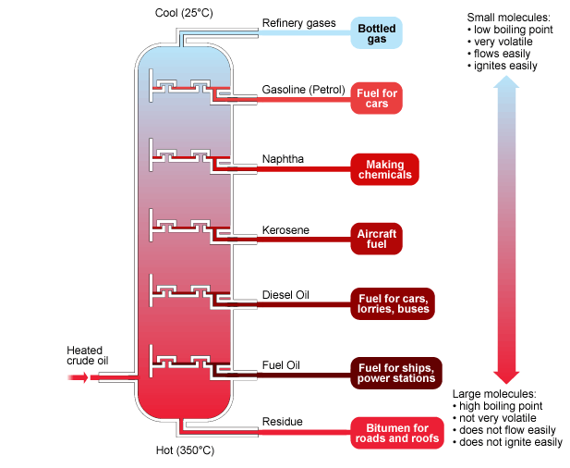
Gary set up the fractionating column incorrectly. What would happen to the fractions collected if:
1. There was no temperature gradient in the column and it was all at 10,000 ºC?
2. He didn't switch on the heater so it was 25 ºC throughout the column?
3. The mixture of crude oil he used only contained long hydrocarbons?
4. The mixture of crude oil he used only contained short hydrocarbons?
5. He forgot to put on the bubble caps?
6. He had a cigarette break near the column?

Slide 4
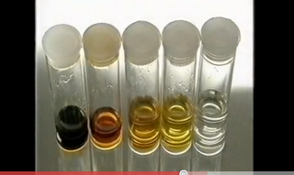
A B C D E
Which fraction is most viscous?
Which fraction would form at the bottom of the column?
Which fraction had the lowest boiling point?
Which fraction would be most useful as a road surface?
Which fraction would be most volatile?
Which fraction contains the longest molecules?
Which fraction would be best used as a fuel?

