Slide 1
Topic | Particle model | Level | Key Stage 3 (or any other course for students aged 11-14)
Outcomes | Students think deeply about the particle model
www.thescienceteacher.co.uk | resources for science teachers who like to think

Slide 2
Instructions
In small groups students discuss each question
Students then write down their own individual answers
Answers are then discussed as a class and students improve their answers

Slide 3
Why don’t the gas particles fall to the bottom of the beaker?

Slide 4
What exists between particles in a solid?

Slide 5
If you pump air into a football does the mass increase, decrease or stay the same?

Slide 6
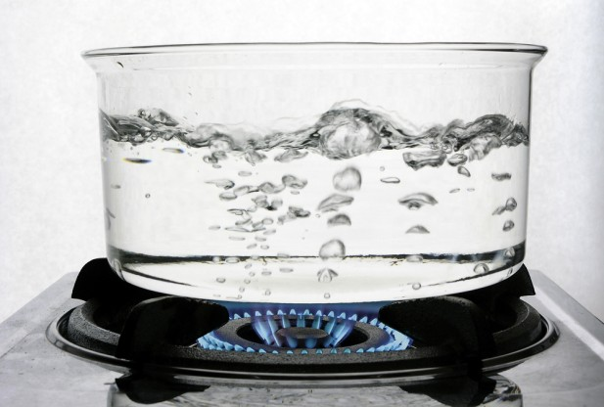
What are bubbles made of in boiling water?

