Slide 1
Topic | Bacterial growth | Level | GCSE (or any other course for students aged 14-16)
Ouctomes | To calculate how many bacteria are present after 24h To appreciate why bacterial infections are potentially so dangerous
www.thescienceteacher.co.uk | resources for science teachers who like to think

Slide 2
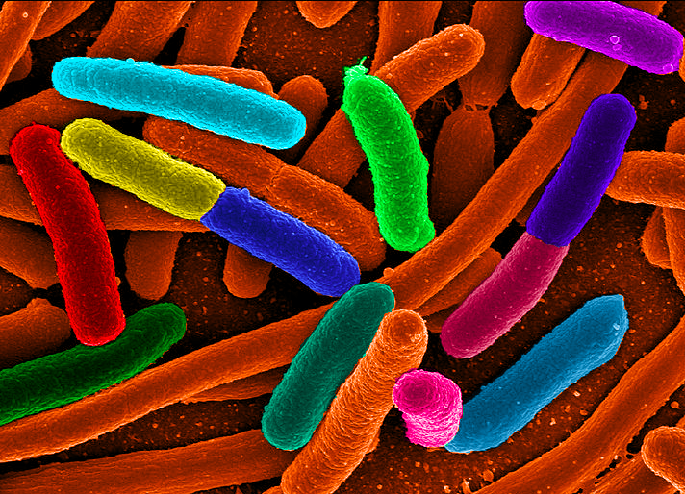
E. coli divides about once every 20 minutes. If a patient was infected with one bacterium, how many bacteria would there be after 24 hours?

Slide 3
4722366500000000000000

Slide 4
Assume the patient had a mass of 72 kg before infection and each bacterium has a mass of 9.5 x 10⁻¹³ g. What would be the new mass of the patient? Why in reality does the patient not reach this mass?

Slide 5
Working out
24 hours = 1440 minutes
1440/20 = 72 divisions
Each division doubles the number
2⁷² = 4722366500000000000000 bacteria

