Slide 1

Topic | Photosynthesis equation | Level | GCSE (or any course for students aged 11-16)
Outcomes | To consider how the symbol equation for photosynthesis relates to the substances and processes involved (e.g. H₂O relates to water in the soil that enters the plant via root hair cells through osmosis) To annotate
Information for teachers | Students can often write the equation for a process such as photosynthesis but have little understanding of what the symbols mean. For example, that H₂O refers to water from the soil and not the air. This activity could be used to activate prior knowledge before teaching or as a revision activity at the end of a topic. Students could work on this in pairs or alone. You could adapt this activity by using a word equation. You might want to model one annotation so students are clear on what they need to do. The word annotation might need explaining too.
Pedagogy focus | This activity uses a goal-free type problem to explore what students know. Slide 3 could be used after the activity to help students connect together the different levels of scientific knowledge e.g. macroscopic to microscopic.
https://thescienceteacher.co.uk | science thinking resources and pedagogy

Slide 2
Annotate this equation to show everything you know about it
Some ideas to include:
names
displayed formula
where the substances come from and go to
how the substances enter the plant
uses of the products
6CO₂ + 6H₂O 6O₂+ C₆H₁₂O₆
light
chlorophyll

Slide 3

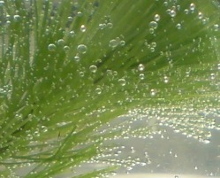
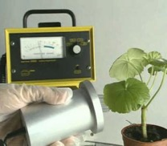
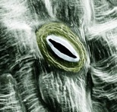
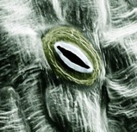
Layers of meaning to understand photosynthesis
Macroscopic and tangible
carbon dioxide enters and exits a leaf through stomata
water enters the plant through
root hair cells
chlorophyll in chloroplasts absorbs energy
oxygen enters and exits a leaf through stomata
glucose may accumulate in the vacuole
Microscopic
cellular
carbon dioxide molecules in the air and leaf
water
molecules in the soil and plant
photons of light striking chlorophyll molecules
oxygen
molecules in the air, soil and plant
glucose
molecules inside the plant
Molecular
and invisible
Symbolic
6CO₂ + 6H₂O 6O₂+ C₆H₁₂O₆
light
chlorophyll
Notes:
Image sources:
Using radioactive carbon 14: https://www.youtube.com/watch?v=bpBJ_Y1bH40
Global chlorophyll concentration in oceans and leaf area index: https://www.dlr.de/rd/en/DesktopDefault.aspx/tabid-4285/6884_read-45747/gallery-1/gallery_read-Image.28.27250/
Bubbles of oxygen: http://helpmyphysics.co.uk/wordpress/?p=134
Stomata: http://www.cellimagelibrary.org/images/39084
Protoplast of a grape cell: http://www.ajevonline.org/content/62/3/270
Chloroplasts: https://commons.wikimedia.org/wiki/File:Moss_chloroplasts_100%C3%97_objective_oblique.jpg

