Slide 1
Prepare to be confused
There are four challenges in this slide deck
Complete the activity as outlined then review the answer on the next slide
Reflect on how the confusion was initiated, and to what extent it was beneficial or problematic for learning
Challenge activities:
A: Particles
B: Leaf
C: Barium sulfate

Slide 2
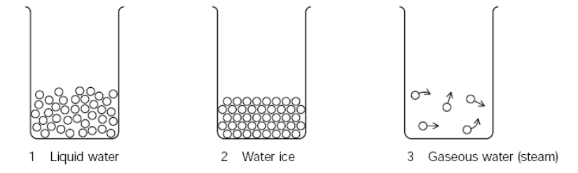
All materials are represented at room temperature.
T1q
Instructions. Working independently, make a list of all the deliberate shortcomings of these five models in 1 minute. Discuss answers as a group before turning this sheet over for feedback.
Source: National Strategy

Slide 3
Answers
T1a
Overall: Remember that no visual model can be absolutely correct. We use different pictures to help explain different phenomena or properties. Any visual model has its strengths and weaknesses. None of these examples show any vibration.
Additionally:
Liquid water: does not show the movement of the water particles which will be in all directions (Brownian motion). The surface should be smoother. There is no evaporation shown (liquid is at room temperature). The spaces between the particles should be smaller (compare the number of water particles in the ice – there should be similar numbers in liquid water).
Water ice: no melting is shown. Condensation could be shown on the walls of the container.
Gaseous water: the particles should be moving in all directions and ideally some collisions should be shown. Some of the direction of movement is not in a straight line. The upper space of the container has no particles.
Air: only one type of particle is shown. The upper space of the container has no particles. No collisions are shown.
Sugar solution: no evaporation is shown. Spaces between the water particles are too large.
Source: National Strategy

Slide 4
Which leaf will lose the most water? Arrange the leaves in order of increasing water loss. Start with the leaf that you think will lose the least water. Justify your choice. You can assume the concentration of water vapour outside each leaf is the same.
T2q
Leaf A
Leaf C
H₂O(g)
Leaf B
Leaf D
Source: the science teacher

Slide 5
T2a
Answers
Leaf A – thick waxy cuticle and only one stoma on the underside of the leaf so water loss is minimal
Leaf C – thinner waxy cuticle on upper epidermis so will lose more water than A. But, still only one stoma on the underside of the leaf so less water lost than D
water loss
Leaf D –two stomata on the underside of the leaf so more water loss than C that only has one stoma
Leaf B –two stomata but one is on the upper side of the leaf so will lose more water than the stomata in leaf D which are both on the leaf underside
Source: the science teacher

Slide 6
T3q
[0.5]
[0.5]
Produce a step by step method of how you would do this experiment.
.
Source: thescienceteacher.co.uk

Slide 7
T3a
Answers
Use the indicator to identify the acid and alkali
Add excess sodium hydroxide to copper sulfate to make insoluble copper hydroxide and sodium sulfate. Note the stoichiometry here – you need twice as many moles of NaOH as CuSO₄
2NaOH(aq) + CuSO₄(aq) → Na₂SO₄(aq) + Cu(OH)₂(s)
Filter to remove copper(II) hydroxide precipitate
Take sodium sulfate and react with a drop of barium chloride to make insoluble barium sulfate and aqueous sodium chloride
Na₂SO₄(aq) + BaCl₂(aq) → 2NaCl(aq) + BaSO₄(s)

Slide 8
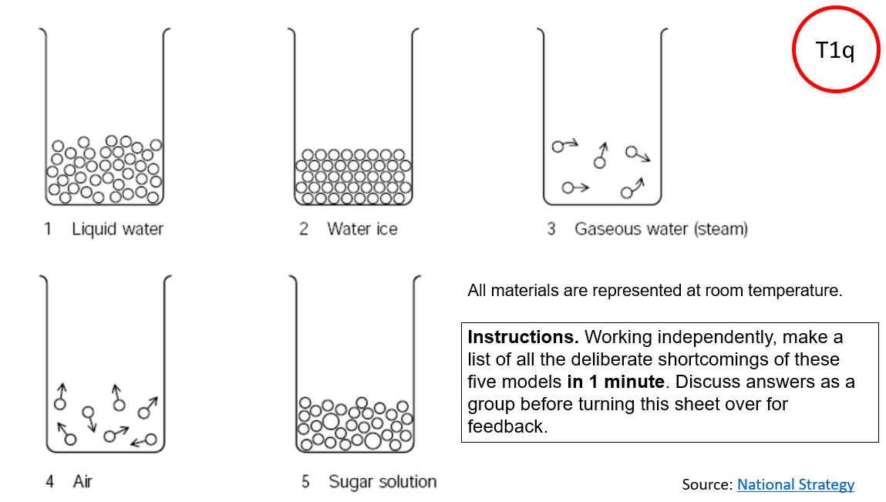
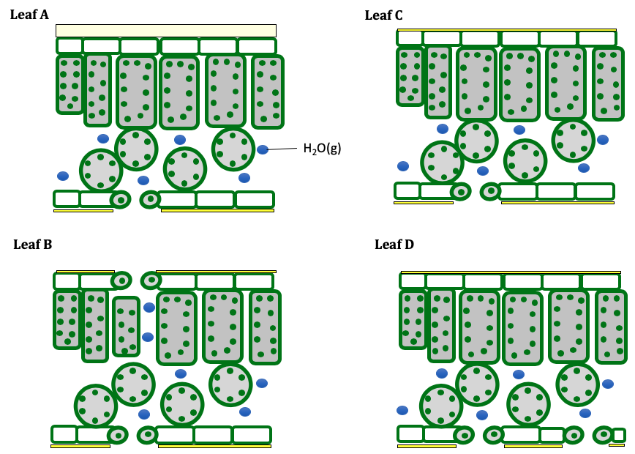
Some reflections so far
Particle model
The leaf
Making a visible product
Which activity did you learn the most from and why?

