Slide 1
Topic | Air pressure | Level | Key Stage 3 (or any course for students aged 11-16)
Outcomes | Students use the particle model to explain how air pressure can exert a force on an object.
Information for teachers | Demonstrate the egg in the bottle. Explain the science and then ask students to describe and explain what happened using slide 2. Make sure students have a secure understanding of pressure and the particle model before attempting this demonstration. There is a common misconception that the oxygen inside the bottle is used up. However, this would not cause the egg to be pushed into the bottle by the outside air pressure because carbon dioxide and water vapour would also be produced. Instead, the match causes the air particles inside the bottle to warm up, travel faster and spread out (a few will leave the bottle). When these particles cool down they move closer together and the air pressure inside the bottle decreases. The outside air pressure is now greater than the air pressure inside the bottle (more particles hitting the egg from the top than the bottom) and so the egg is pushed into the bottle (NOT sucked).
Other resources | Other resources on pressure are here: http://thescienceteacher.co.uk/pressure/
www.thescienceteacher.co.uk | resources for science teachers who like to think

Slide 2
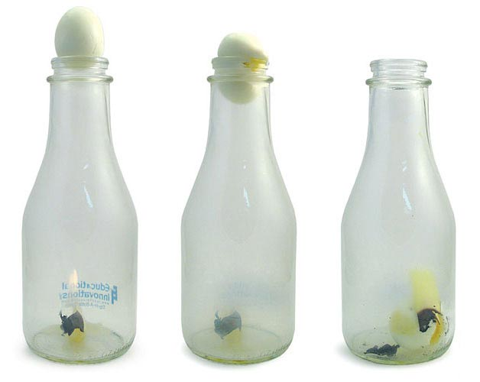
Describe and explain what happened to the egg and air particles (inside and outside the bottle) in steps 1-5.
1
2
3
4
5
Source: adapted from https://www.teachersource.com/product/milk-bottle--egg-demo/air-pressure

Slide 3
Some people incorrectly believe the egg is sucked into the bottle because oxygen is used up by the fire. Explain why this is wrong.
1
2
3
4
5
Source: adapted from https://www.teachersource.com/product/milk-bottle--egg-demo/air-pressure

