Slide 1
Topic | Osmosis | Level | GCSE (or any course for students aged 11-16)
Outcomes | To think about what happens when we add solute to a U-shaped tube containing water, separated by a membrane
Information for teachers | Use this thinking task to get students to engage with the process of osmosis. This could be used at the start of the topic to challenge and motivate students to solve a problem. Whilst students may not arrive at the right answer, it will focus their thinking on the parts of the problem i.e. membrane, solute and water, making any explanations that follow more relevant and likely to stick. Provide 5 minutes for students to write down there thinking once you outline the problem on slide 2, then 3 minutes to discuss their thinking with their partner, 3 minutes to share with the class and finally 5 minutes to re-draft their answer after some teacher explanation using slide 5. Finally, they can make corrections to their once you have shown them slide 6.
www.thescienceteacher.co.uk | resources for science teachers who like to think

Slide 2
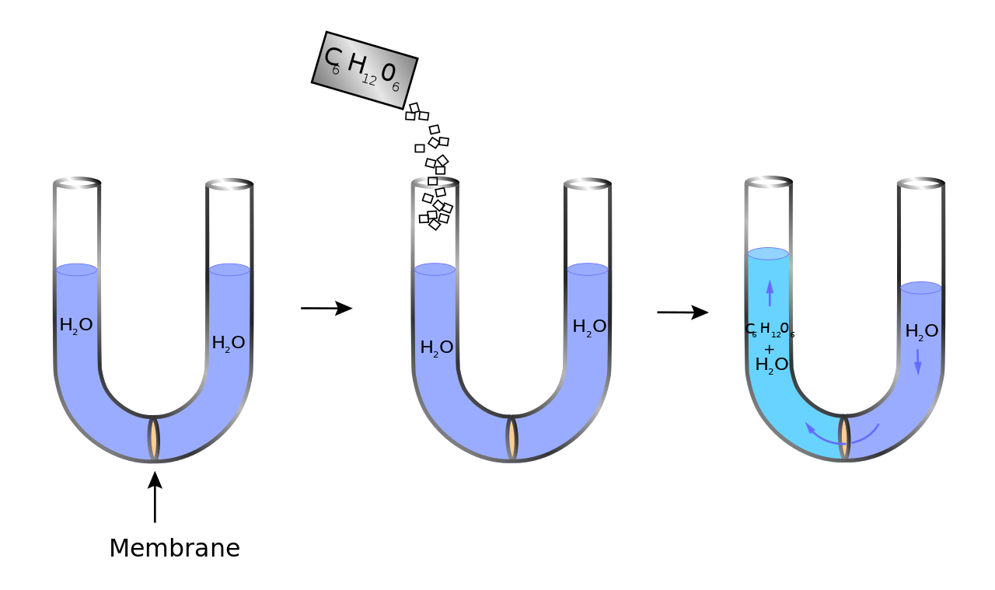
What happens next?
Write
?

Slide 3
What happens next?
Write
Pair
?

Slide 4
What happens next?
Write
Pair
?
Share

Slide 5
What happens next?
Write
Pair
Share
Re-draft

Slide 6
How did you do?
The sugar dissolved in the water.
The sugar could not pass through the selectively permeable membrane as the particles were too large.
This increased the concentration of solute (sugar) in the left-hand side of the U-tube (and decreased the concentration of water molecules).
Overall, water molecules moved from an area of higher concentration (right-hand side) to an area of lower water concentration, through the selectively permeable membrane.
The movement of water into the left-hand side created a force which pushed the water level up on the left-hand side.

