Slide 1
Topic | Hypertonic, hypotonic and isotonic solutions | Level | GCSE (or any course for students aged 11-16)
Outcomes | Be able to describe and explain the effect of hypotonic, hypertonic and isotonic solutions on animal cells.
Information for teachers | This activity could be used to consolidate understanding around osmosis and the effects of hypotonic and hypertonic solutions on cells.
www.thescienceteacher.co.uk | resources for science teachers who like to think

Slide 2
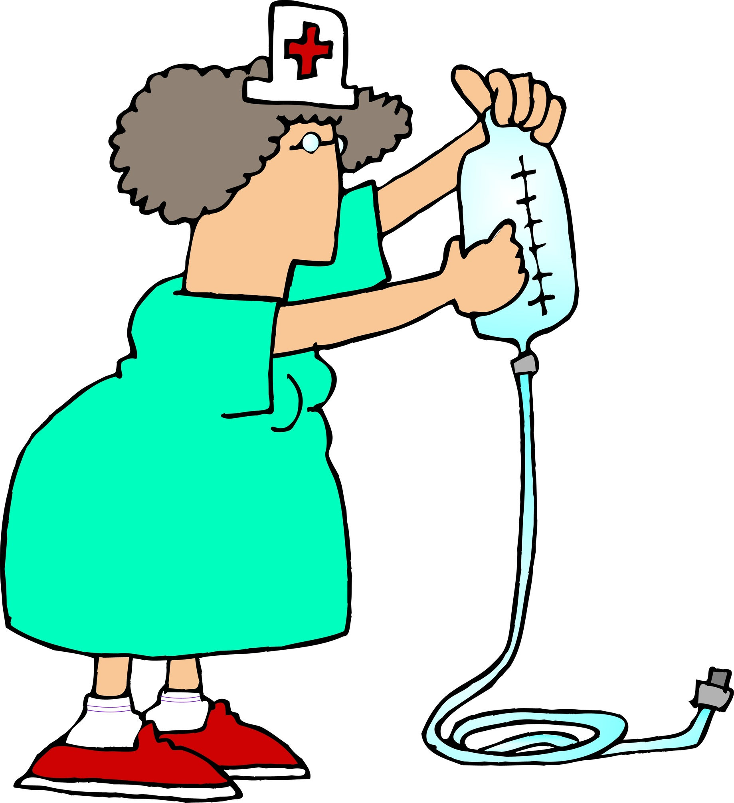
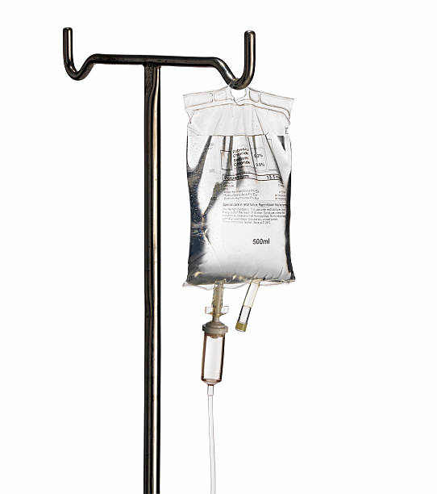
Nurse Maggie
Frank is dehydrated and in hospital.
Maggie the nurse is here to help. She has got two intravenous drips. One drip contains sterile water only. The other drip contains a sterile saline solution (0.9% NaCl). Explain, with reference to osmosis, why Maggie should not administer the sterile water!
In your answer explain:
what would happen to Frank’s cells if water was used
why drips contain NaCl (0.9%)
why drips don’t contain more than 1% NaCl
Include and explain the terms hypertonic, isotonic and hypotonic.

