Slide 1
Topic | Internal energy | Level | Key Stage 4 (or any course for students aged 14-16)
Outcomes | To understand that internal energy is the total kinetic energy and potential energy of all the particles (atoms and molecules) that make up a system To understand that temperature is a measure of the average kinetic energy of particles in a system To describe what happens to kinetic energy and potential energy stores when you heat a substance
Information for teachers | This activity is designed as an introduction to the concept of internal energy. Students should already have a sound understanding of the particle model and state changes before this lesson. For the demonstration you will need a beaker of crushed ice, thermometer and heat source.
www.thescienceteacher.co.uk | resources for science teachers who like to think

Slide 2
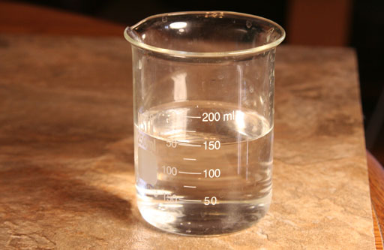
This beaker is at 60 ºC
Describe the motion and arrangement of the water molecules inside the beaker.
Draw a picture to represent the motion and arrangement of the particles.
What energy is stored inside this beaker?
What happens to this energy store if we heat the beaker?
Notes:
Purpose: to introduce new ideas, making sure that you start from what your students already know. Create time to identify and remedy misconceptions.
Ideas for checking prior knowledge:
Spider diagram
Concept cartoons
Open questions
True or false
Draw a picture of … e.g. draw a picture to show what respiration is.
MCQ quizzes
Ideas for introducing new knowledge:
Direct instruction using the white board
Demonstration – predict, observe and explain
Video and questions

Slide 3
This beaker is at 60 ºC
Internal energy of the beaker
Kinetic energy store
Internal energy
Potential energy store
Kinetic energy store
Potential energy store
Notes:
Purpose: to introduce new ideas, making sure that you start from what your students already know. Create time to identify and remedy misconceptions.
Ideas for checking prior knowledge:
Spider diagram
Concept cartoons
Open questions
True or false
Draw a picture of … e.g. draw a picture to show what respiration is.
MCQ quizzes
Ideas for introducing new knowledge:
Direct instruction using the white board
Demonstration – predict, observe and explain
Video and questions

Slide 4
Think, Pair, Share
A
B
When does the bow have the most potential energy? In picture A or B and explain.

Slide 5
What happens when we heat a substance?
Heat a substance
Internal energy increases
Temperature increases
Temperature stays the same
State change takes place
Kinetic energy store increases
Potential energy store increases
Notes:
Purpose: to introduce new ideas, making sure that you start from what your students already know. Create time to identify and remedy misconceptions.
Ideas for checking prior knowledge:
Spider diagram
Concept cartoons
Open questions
True or false
Draw a picture of … e.g. draw a picture to show what respiration is.
MCQ quizzes
Ideas for introducing new knowledge:
Direct instruction using the white board
Demonstration – predict, observe and explain
Video and questions

Slide 6
Explain the difference between potential and kinetic energy stores using the pictures below.
A
C
B
D

Slide 7
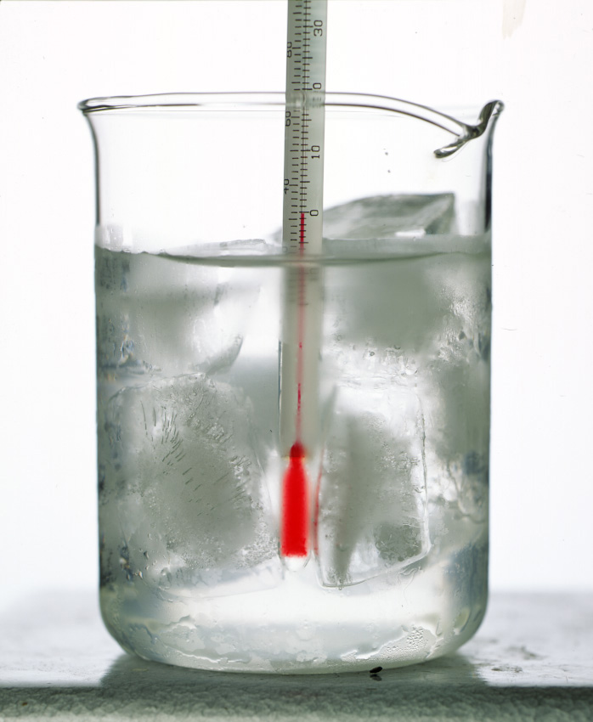
What happens to the internal energy when we heat ice?

Slide 8
DEMONSTRATION: What happens to the internal energy when we heat a beaker of crushed ice?
melting ice
warming water
boiling water
Temperature change:
increase
decrease
remain constant
Temperature change:
increase
decrease
remain constant
Temperature change:
increase
decrease
remain constant
Particle picture
Particle picture
Particle picture
What is happening to the kinetic energy store?
increases
decreases
remains constant
What is happening to the kinetic energy store?
increases
decreases
remains constant
What is happening to the kinetic energy store?
increases
decreases
remains constant
What is happening to the potential energy store and why?
What is happening to the potential energy store and why?
What is happening to the potential energy store and why?
time (min)

Slide 9
What happens to the internal energy when we heat a beaker of crushed ice?
melting ice
warming water
boiling water
Temperature change:
increase
decrease
remains constant
Temperature change:
increase
decrease
remains constant
Temperature change:
increase
decrease
remains constant
Particle picture
Particle picture
Particle picture
What is happening to the kinetic energy store?
increases
decreases
remains constant
What is happening to the kinetic energy store?
increases
decreases
remains constant
What is happening to the kinetic energy store?
increases
decreases
remains constant
What is happening to the potential energy store and why? It is increasing because the substance is changing from a solid to a liquid.
What is happening to the potential energy store and why? It remains constant as there are no state changes.
What is happening to the potential energy store and why? It is increasing because the substance is changing from a solid to a liquid
time (min)

