Slide 1
Topic | The eye | Level | Key Stage 4 (or any course for students aged 11-16)
Outcomes | Students can describe and explain the role of the cornea, lens, pupil, iris, retina and sclera in vision. Students use their knowledge of eye structure to problem solve and make a diagnosis
Information for teachers | This activity should be used once students have a good understanding of the different parts and functions of the eye. Students could work in pairs to complete the table and take on the role of an optician as they diagnose their patients’ problems.
www.thescienceteacher.co.uk | resources for science teachers who like to think

Slide 2
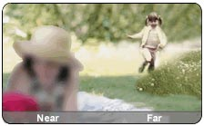
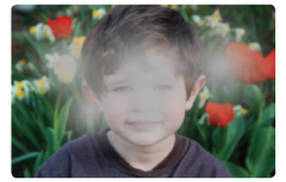
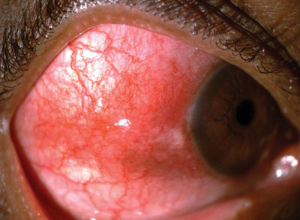
Patient’s world
Part(s) of the eye that may not be working:
Explain your diagnosis:
Part(s) of the eye that may not be working:
Explain your diagnosis:
Part(s) of the eye that may not be working:
Explain your diagnosis:
Part(s) of the eye that may not be working:
Explain your diagnosis:
Part(s) of the eye that may not be working:
Explain your diagnosis:

Slide 3
Patient’s world
Part(s) of the eye that may not be working: cone cells in the fovea of the retina.
Explanation: the image is in black and white. This suggests that that cone cells are not working because they detect colour. The disorder is caused achromatopsia and is a rare medical syndrome. These individuals rely on using rod cells to see.
Part(s) of the eye that may not be working: cornea (or short eye ball)
Explanation: the image far away is clear suggesting that light from near objects cannot be focused properly onto the retina. As the cornea does most refracting it is probably not curved enough in this patient. Instead of light being focused precisely on your retina, light is focused behind your retina, resulting in a blurry image.
Part(s) of the eye that may not be working: circular muscles of the iris.
Explanation: too much light is entering the eye and so it is probably caused by the circular iris muscles not constricting enough. This could be caused by trauma to the iris muscles or neurological problems.
Part(s) of the eye that may not be working: lens of the eye.
Explanation: the image looks cloudy and this suggests the transparency of the lens has been lost. This could be because clumps of protein have formed in the lens. This is called a cataract and prevents some light from reaching the retina.
Part(s) of the eye that may not be working: sclera.
Explanation: the sclera looks inflamed because it is red and puffy. This is caused scleritis but is not usually caused by bacteria or viruses unlike conjunctivitis which is an infection of the conjunctiva.

