Slide 1
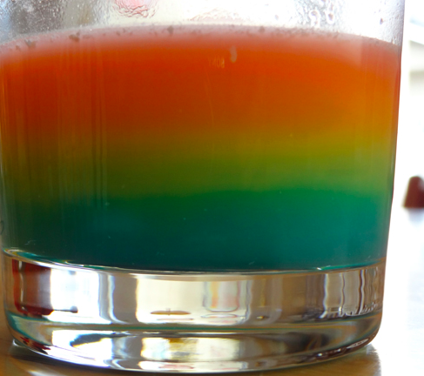
Topic | Density and the particle model | Level | For students aged 11-16
Outcomes | To calculate the density of solutions To apply the particle model to density To explain floating and sinking in terms of density
Instructions for teachers – this demonstration can be a great introduction to the concept of density. Students should already have been introduced to the particle model. Practice the demonstration first and it is probably best to dissolve the skittles in a previous lesson as this takes time.
www.thescienceteacher.co.uk | resources for science teachers who like to think

Slide 2
Instructions for the demonstration
Idea adapted from Candy Experiments by Loralee Leavitt,
Apparatus you will need:
5 small cups, 1 cup of hot water, a tablespoon, a plastic pipette. You’ll also need one pack of skittles: 2 red, 4 orange, 6 yellow, 8 green and 10 purple ones.
Method:
Pour 20 cm³ of warm water into each glass using a measuring cylinder
Record the mass of one skittle (we will assume all skittles have the same mass)
Pick the required number of skittles and put them into the glasses
Stir to dissolve and leave for 60 minutes.
Let the liquid cool down to room temperature
Using a pipette, pour the colored liquid into a small glass jar, starting with the most dense color (purple) and ending with the least dense color (red)
Drip the coloured liquid in carefully, otherwise all the layers will get mixed up.
It’s better to make the liquids flow down the side of the jar slowly
You should get a rainbow of skittle colours

Slide 3
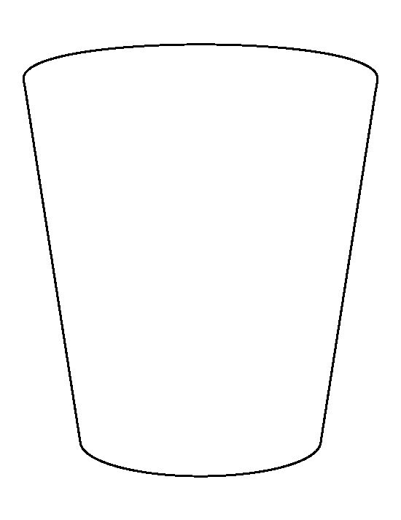
Colour | Red | Orange | Yellow | Green | Purple
Skittles | 2 | 4 | 6 | 8 | 10
Volume of water (cm³) | 20 | 20 | 20 | 20 | 20
Mass off skittles + water (g)
Density (g/cm³)
Draw particle pictures to represent the number of water and solute particles in each of the glasses
Complete the table above and calculate the density of each layer
Using your knowledge of density and the table to help you, explain why the yellow layer is on top of the purple layer but underneath the red layer
Use the idea of density to explain why a penny sinks but a ferry floats

