Slide 1
Topic | Carbon cycling | Level | GCSE (or any course for students aged 14-16)
Outcomes | Describe how carbon cycles through the abiotic and biotic components of an ecosystem as a result of respiration, combustion, photosynthesis and decomposition Evaluate the relative advantages and disadvantages of heather burning in the context of the carbon cycle
Information for teachers | In this activity we explore the carbon cycle through the context of heather burning in Scotland. It’s a simple context that I hope will give students a more concrete understanding of this abstract process. Students should have already been introduced to combustion, respiration and photosynthesis before they apply this knowledge to understanding the carbon cycle.
www.thescienceteacher.co.uk | resources for science teachers who like to think

Slide 2
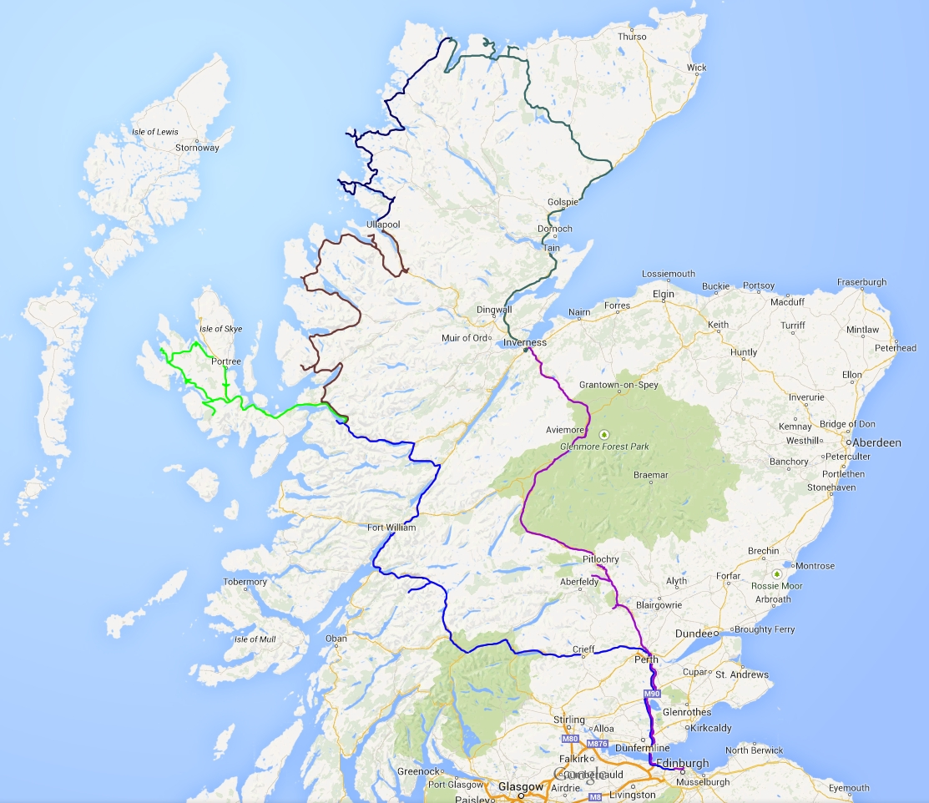
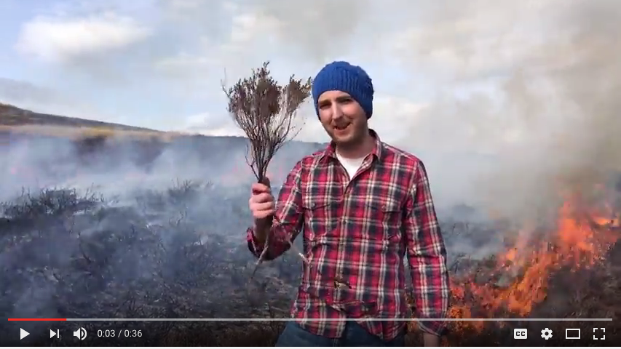
Let’s set the scene. Welcome to the Scottish Highlands.
https://youtu.be/MBTUZ30YMUY

Slide 3
Discuss in your pairs the following question.
What are the possible ecological advantages and disadvantages of burning heather?
Complete the table below with your initial ideas.
Possible advantages of heather burning
Possible disadvantages of heather burning

Slide 4
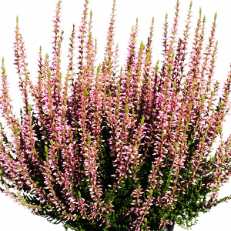
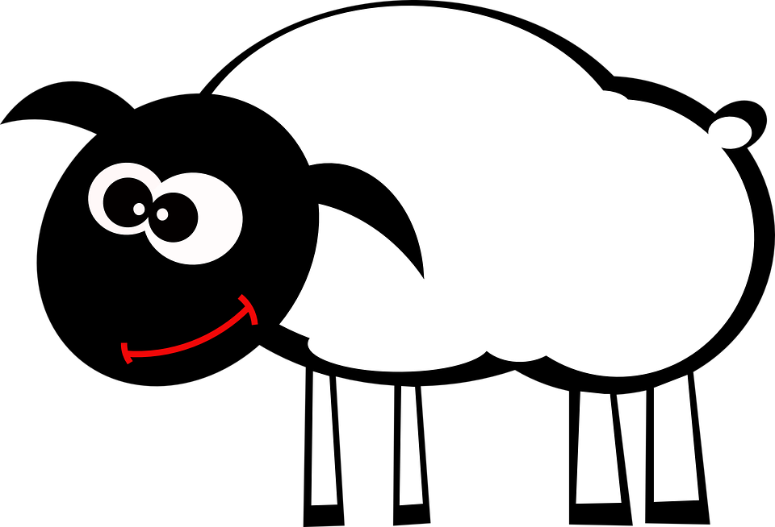
Complete this diagram to show how C is cycled around this highland ecosystem by: photosynthesis, respiration, decomposition and combustion.
Use arrows to show the movement of carbon.
CO₂
Bog vegetation containing bacteria
Peat (C) containing bacteria

Slide 5
A. Discuss each statement below, does it describe an advantage or a disadvantage of burning heather?
1. Burning removes dense canopies of heather and creates hydrological and light conditions that favour the rare Sphagnum moss species.
2. By creating a patchwork of different aged heathers there will always be some young heather for grouse, sheep, deer and mountain hares to feed on that is nutritionally richer and more digestible.
3. Under drought conditions, wildfires can ignite peat layers beneath the surface causing smouldering peat fires and large emissions of C to the atmosphere in the form of CO₂.
4. Fire may stimulate microbial activity within the peat layer and increase the rate of decomposition leading to a loss of C from the store.
B. Now use these ideas, together with your own knowledge, to write an answer to the following question.
How is carbon cycling affected by heather burning: should we burn moor or burn less?!
Ideas above adapted from: Davies GM et al. 2016 The role of fire in UK peatland and moorland management: the need for informed, unbiased debate. Phil. Trans. R. Soc. B 371: 20150342

