Slide 1
Topic | Levers | Level | For students aged 11-16
Outcomes | To identify the fulcrum, effort and load To understand how a lever works To compare and contrast different types of lever To use and understand Work = Force x Distance
Instructions for teachers: students work in groups of 3 and each group has one copy of each slide from this presentation. They discuss each problem and then answer the questions in their books
If would be great to provide each group with some simple lever machines e.g. scissors, a toy rowing boat, and a mini seesaw!
www.thescienceteacher.co.uk | resources for science teachers who like to think

Slide 2
A seesaw
Sketch this diagram into your book. Label the fulcrum.
What is the mass of box A? How do you know?
Box B has a mass of 20 kg. If you remove box A, where would you place box B so that the seesaw is still balanced? Add this onto your diagram.
A
40 kg
B

Slide 3
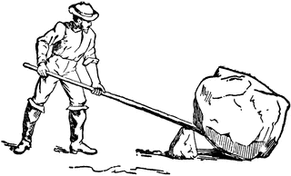
Work = Force x Distance
John says that he was able to use a lever to lift an object with a weight of 100 N using only an effort force of 50 N.
Tariq says “that this can’t be right, as the input work and output work of any machine have to be the same. We can’t create energy John”.
Explain why Tariq is wrong using the picture below to help.

Slide 4
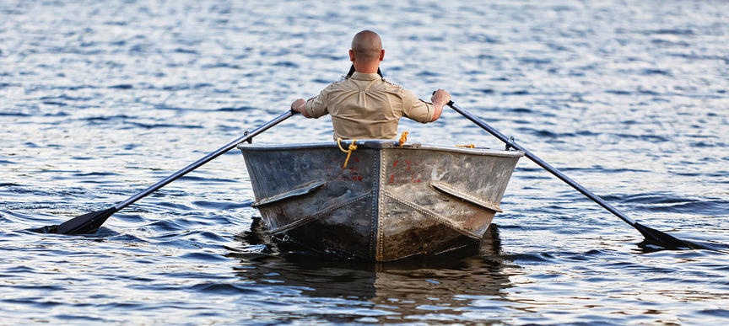
A rowing boat
Sketch a rowing boat and label the fulcrum
Label the effort and the load
If you were to redesign this boat so that the rower could row with less effort, what changes would you make to the lever?

Slide 5
A wheelbarrow
Sketch a wheelbarrow and label the fulcrum.
Label the load
Label the effort
Explain how this lever is similar and different to a seesaw

Slide 6
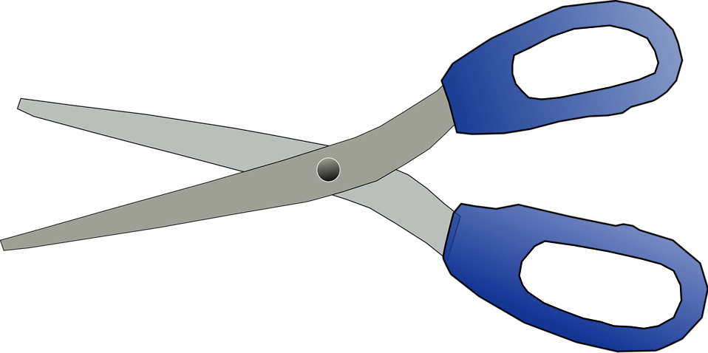
Scissors
Jenny uses the scissors to cut some rope. She places the rope between the blades at position 1 but the rope is too tough to cut. Explain why moving the rope to position 2 allowed Jenny to cut the rope.
2
1

