Slide 1
Topic | Refraction and Snell’s law | Level | Key Stage 4 (or any course for students aged 14-16)
Outcomes | To understand what happens to light as it travels through media of different densities Use Snell’s law to calculate angle of refraction
Information for teachers | Waves can be transmitted, reflected or absorbed. Refraction is a phenomenon associated with transmission. Refraction is commonly taught with respect to two interfaces, i.e. air/glass/air and is often described as light ‘bending’ towards the normal as it enters the more optically dense medium and ‘bending’ away from the normal as it leaves the more optically dense medium. But what happens to light if it goes through more than one different material? Get your students to complete the worksheet by getting them to draw normal lines and refracted rays. Make sure your students can draw normal lines before completing this worksheet. To stretch students, ask them to calculate the angle of refraction at each boundary and hence calculate the final angle of refraction using the refractive index of each material listed below. Refractive index (n): Air = 1 Water = 1.3 Glass = 1.5 Diamond = 2.4 You can check your answers using this refraction calculator: http://scienceprimer.com/snells-law-refraction-calculator
www.thescienceteacher.co.uk | resources for science teachers who like to think

Slide 2
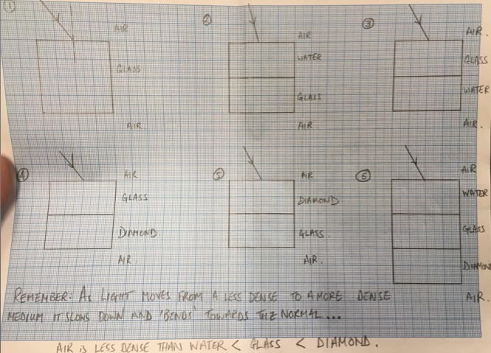
Fill this box if students require less support,

