Slide 1
Topic | Ecology definitions | Level | Key Stage 3 and GCSE (or any course for students aged 11-16)
Outcomes | To be able to define and give examples of the following terms: species, population, community, habitat, ecosystem, niche, interspecific and intraspecific competition
www.thescienceteacher.co.uk | resources for science teachers who like to think

Slide 2
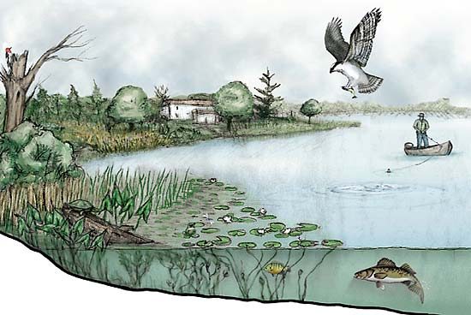
Find an example from the picture to explain the following terms:
species
population
community
habitat
ecosystem
niche
one example of interspecific competition
one example of intraspecific competition

