Slide 1
Topic | Gravity, weight and air resistance | Level | GCSE (or any course for students aged 11-16)
Outcomes | To explain why free falling objects hit the ground at the same time To calculate the acceleration of a free falling object To describe how and why air resistance affects falling objects by drawing free body diagrams
www.thescienceteacher.co.uk | resources for science teachers who like to think

Slide 2
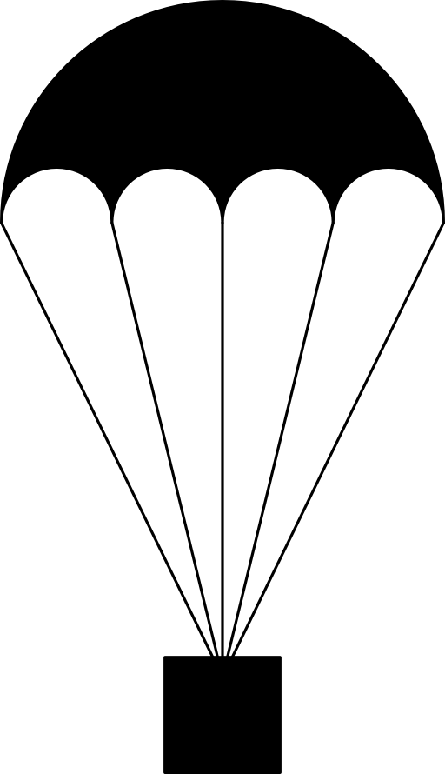
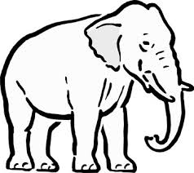
What I think…
4,500 kg
1 kg
1kg
1kg
5kg
9kg
The four boxes above are dropped from an aeroplane. At the same time and height, an elephant runs off the cliff.
Which box(es) will hit the ground first? Explain.
Which box(es) will hit the ground last? Explain.
The elephant has a greater air resistance than the parachute. So why does the elephant hit the ground before the black box?

Slide 3
What I now think…
4,500 kg
1 kg
1kg
1kg
5kg
9kg
The gravitational field strength on Earth is 10 N/kg. Using the equation: acceleration = F_{net}/m calculate the acceleration due to gravity (g) for each colored box. Now review your answer to question 1.
As the parachute falls, it collides with air particles creating an upward force called air resistance. What effect will drag have on the acceleration of the black box? Refer to the equation above in your answer. Now review your answer to question 2.
Calculate the downward force (weight) for both the elephant and the black box. Assuming both objects experience equal amounts of air resistance, draw free body diagrams of both objects as they fall. Now review your answer to question 3.

