Slide 1
Topic | Free body diagrams | Level | GCSE (or any course for students aged 11-16)
Outcomes | To draw forces acting on a tennis ball To recall and understand Newton’s first law of motion
www.thescienceteacher.co.uk | resources for science teachers who like to think

Slide 2
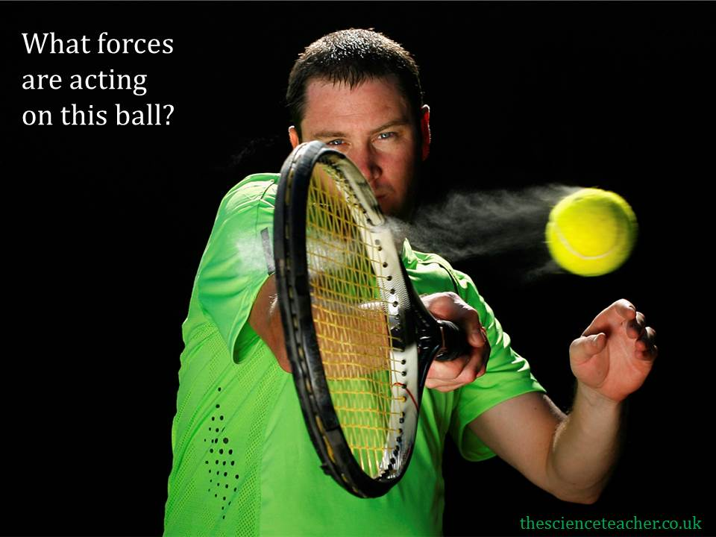

Slide 3
Air resistance
Weight

Slide 4
Newton’s First Law
Newton's first law says that a body stays at rest or moves at a constant velocity unless an unbalanced force acts on it.

