Slide 1
Topic | Peer assessment in science | Level | Teachers
Outcomes | To understand how to use peer assessment effectively in the classroom
www.thescienceteacher.co.uk | resources for science teachers who like to think

Slide 2
Learning Goals
Make it clear where you are heading… we always cook the recipes with a photo!

Slide 3
Peer assessment
Can be used by learners and their teachers to decide where students are in their learning, whey need to go and how best to get there

Slide 4
Why?
Improved motivation
Language used is understandable
Peer feedback can command more attention
Frees up the teacher to make interventions

Slide 5
Peer assessment
http://www.journeytoexcellence.org.uk/videos/expertspeakers/selfandpeerassessmentdylanwiliam.asp
formative
summative

Slide 6
Creating effective peer assessment
give time
for redrafting
and persevere
model what good peer assessment looks like – set up routines
use clear, open tasks with success criteria
what’s good and why?
Even Better If…..

Slide 7
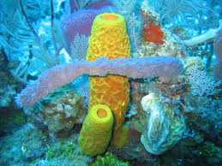
Goal: to be able to describe the key features of sponges

Slide 8
Goal: to be able to describe the key features of sponges
Success criteria shared
You correctly identify the Kingdom it is in
You describe how a sponge feeds
You describe the structure of a typical sponge
You describe how a sponge reproduces

Slide 9
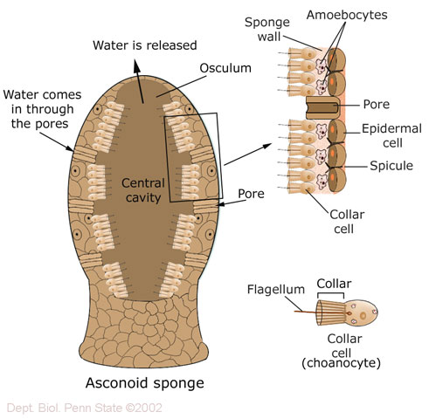

Slide 10
Goal: to be able to describe the key features of the sponges
You correctly identify the Kingdom
They are animals
2. You describe how a sponge feeds
They all live in water
Collar cells line the openings of the sponge and have hair-like projections that waft water into the main cavity – this draws in small food particles
3. You describe the structure of the sponge
Hard exoskeleton made from collagen and calcium
4. You describe how a sponge reproduces
They reproduce by both asexual and sexual reproduction
The sperm are released into the water and then fertilise eggs made by collar cells
Sponges can reproduce asexually by budding

