Slide 1
Topic | Extracting information from titration exam questions | Level | GCSE (or any other course for students aged 14-18)
Outcomes | To describe the stages involved in a titration To extract information from a titration exam question and understand it
www.thescienceteacher.co.uk | resources for science teachers who like to think

Slide 2
Introductory text to an exam question
2.00 grams of impure solid NaOH was weighed out and dissolved in approximately 30 cm³ of distilled water. The solution was then transferred to a volumetric flask and made up to a total volume of 100 cm³ with distilled water. 25.0 cm³ of this solution was then titrated against a standard solution of 0.10 mol dm⁻³ HCl. 12.50 cm³ of HCl was required to reach the end point.
What was the percentage by mass of NaOH in the impure sample?
Given all this information, many students struggle to make sense of what is happening in the titration.
One strategy that can help students to improve their understanding is to chose an exam question from a past paper, and then give students all the apparatus listed in the question. No chemicals are required. Students then us post-it notes to label each item of apparatus with the reagent name and quantity that it contains. Students must then write a number on each post-it to correspond to the order in which the equipment is used. Once students understand the method they can then begin the calculations.
An illustration of how this might work appears on the next two slides.

Slide 3
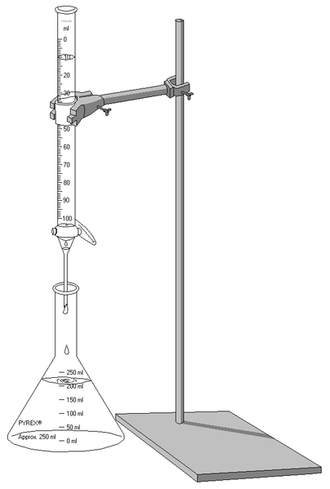
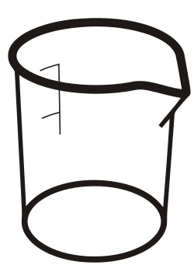
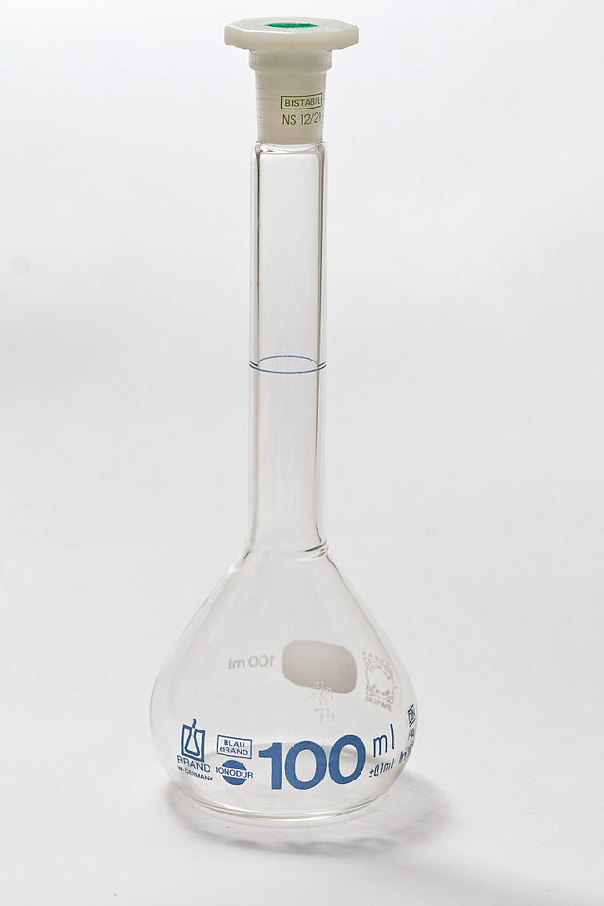
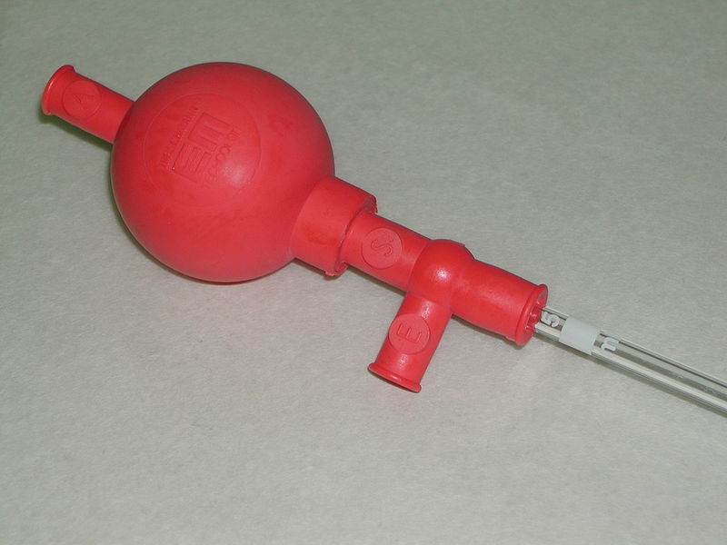
Introductory text to an exam question
2.00 grams of impure solid NaOH was weighed out and dissolved in approximately 30 cm³ of distilled water. The solution was then transferred to a volumetric flask and made up to a total volume of 100 cm³ with distilled water. 25.0 cm³ of this solution was then titrated against a standard solution of 0.10 mol dm⁻³ HCl. 12.50 cm³ of HCl was required to reach the end point.
Students annotate post-it notes on apparatus with information from the exam question

Slide 4
Introductory text to an exam question
2.00 grams of impure solid NaOH was weighed out and dissolved in approximately 30 cm³ of distilled water. The solution was then transferred to a volumetric flask and made up to a total volume of 100 cm³ with distilled water. 25.0 cm³ of this solution was then titrated against a standard solution of 0.10 mol dm⁻³ HCl. 12.50 cm³ of HCl was required to reach the end point.
5.
12.50 cm³ of 0.10 mol dm⁻³ HCl
to reach end point
1.
2.00 g of solid dissolved in H₂O
2.
solution made up to 100 cm³ with H₂O
3.
25.0 cm³ transferred into conical flask
4.
25.0 cm³ of sample
(unknown conc.)

