Slide 1
Topic | Photosynthesis and respiration | Level | Key Stage 3 and GCSE
Outcomes | To write word equations for photosynthesis and respiration To describe and explain the relationship between respiration and photosynthesis To evaluate a model
www.thescienceteacher.co.uk | resources for science teachers who like to think

Slide 2
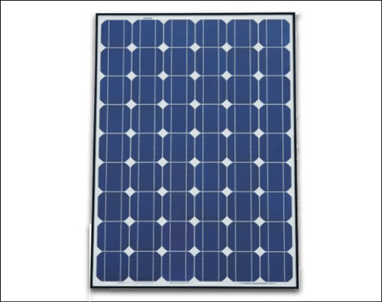
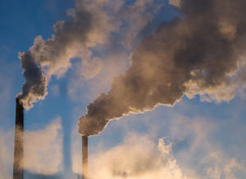
Open 7-11
The chloroplast factory
The mitochondrion factory
The Leaf Factories

Slide 3
What are the names of the processes that happen inside each factory? Use the diagram to write word equations for each process.
Look at the the chloroplast factory. Why does it not work at night?
Circle the most important product of each factory. Explain your choice.
Can you use this diagram to describe and explain the relationship between respiration and photosynthesis in plants?
The mitochondrion factory is open 24 hours a day. How is this possible if the chloroplast factory is closed during the night time?
Animal cells do not have chloroplasts. Where do animal cells get their glucose from?
Complete the Venn diagrams below to compare the models to the real organelles.
How have the leaf factories helped you to understand photosynthesis and respiration in plants?
chloroplast
chloroplast factory
mitochondria
mitochondria factory

