Slide 1
Topic | Checking prior knowledge of anaerobic respiration and fermentation | Level | GCSE (or any course for students aged 14-16)
Outcomes | Can write the symbol and word equations for anaerobic respiration and fermentation Can identify the uses of these processes to biological organisms (energy transfer when oxygen is limiting) and industry (alcoholic drinks and bread making) Can compare and contrast the process of anaerobic respiration and fermentation
Information for teachers | This activity can be used to recap prior knowledge for any topic. Trying to retrieve what you already know from memory can help you remember this knowledge better in the long run. In this activity four students sit around a piece of A3 paper divided into four sections (see the slides 3 and 4). There is a key question or topic written in the centre (slide 3) and some images to stimulate thinking if you want to prompt students (slide 2). Students then spend 30 seconds silently writing down everything they can remember about the question or topic on the area in front of them – the images could serve as a prompt that students can annotate and build on. During this time, the teacher can walk around the room to audit prior knowledge and consider how to adjust the next phase of the lesson. After 30 seconds the piece of paper is rotated clockwise 90 degrees. Students have 30s to build onto their peers’ ideas, again in silence. This process is repeated until everyone has had a chance to build on each area and then students can spend one minute discussing the question/topic. The teacher can then explore the key takeaways on the board before students write individual responses to the long answer questions on slide 4.
www.thescienceteacher.co.uk | resources for science teachers who like to think

Slide 2
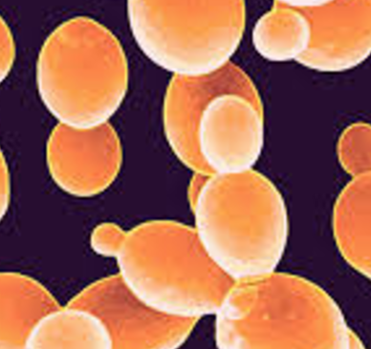
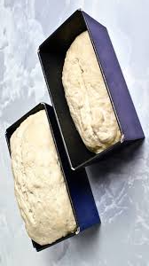
Person C
Person D
Anaerobic respiration and fermentation
.
Person B
Anaerobic
Fermentation
Person A

Slide 3
Person C
Person D
Anaerobic respiration and fermentation
.
Person B
Person A

Slide 4
Compare and contrast the similarities and differences between anaerobic respiration and fermentation.
Suggest why two different processes may have evolved to deal with the problems of oxygen limitation.

