Slide 1
Topic | Do plants respire? | Level | Key Stage 3 (or any course for students aged 11-14)
Outcomes | To understand why plants respire To understand why plants photosynthesise
www.thescienceteacher.co.uk | resources for science teachers who like to think

Slide 2
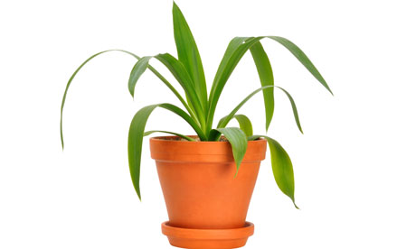
Discuss in pairs
My plant photosynthesises because…..
My dog respires because……
My plant respires because…...
My dog doesn’t photosynthesise because….

