Slide 1
Topic | Melting and dissolving | Level | Key Stage 3 (or any course for students aged 11-14)
Outcomes | To compare and contrast the processes of melting and dissolving with reference to salt and snow
www.thescienceteacher.co.uk | resources for science teachers who like to think

Slide 2
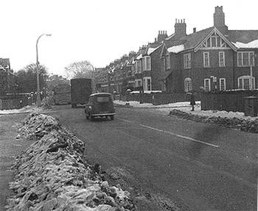
Where has all the rock salt gone?
Where has all the snow gone?

