Slide 1
Topic | Heating curves | Level | Key Stage 3 (or any course for students aged 11-16)
Outcomes | To make a prediction about what would happen to the temperature of an ice cube as we heat it To be able to draw a heating curve for water To understand why the temperature of a substance does not change during a state change
www.thescienceteacher.co.uk | resources for science teachers who like to think

Slide 2
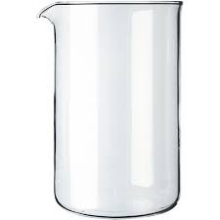
Temperature (ºC)
Time (min)
An ice cube is heated in a beaker. Sketch a graph to show what you think would happen to the temperature of H₂O over time.
HEAT

Slide 3
In pairs, discuss which graph best describes the change in temperature of the H₂O.
Graph A
Graph B
Temperature (ºC)
Temperature (ºC)
Time (min)
Time (min)
Graph C
Graph D
Temperature (ºC)
Temperature (ºC)
Time (min)
Time (min)

Slide 4
Questions to think about
Why does the temperature of a substance not change when it is changing state?
The melting temperature of H₂O is 0 ºC. The freezing temperature of H₂O is 0 ºC. At 0 ºC is H₂O a solid or a liquid?
Does water refer to H₂O(l) only, or is ice water too?

