Slide 1
Topic | Introducing exothermic and endothermic reactions | Level | Key Stage 3 (or any course for students aged 11-14)
Outcomes | Students can describe the energy changes in an endothermic and exothermic reaction Students can draw simple energy level diagrams for exothermic and endothermic reactions
Information for teachers | This activity probes students’ understanding of exothermic and endothermic reactions. It should be used once students have seen and experienced simple exothermic and endothermic reactions in the lab.
www.thescienceteacher.co.uk | resources for science teachers who like to think

Slide 2
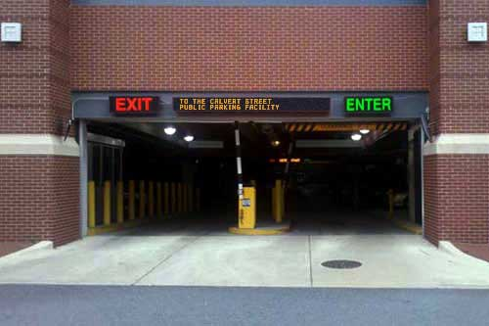
How many words can you think of that begin with Ex or En?
What do these pre-fixes mean?

Slide 3
A reaction is taking place in each beaker. The arrows represent energy transfer.
What would John feel and what would Jack feel?
What would happen to the temperature in beakers A and B?
Beaker A
Beaker B
John
Jack

Slide 4
Beaker A is an endothermic reaction
Beaker B is an exothermic reaction
Energy
Energy
products
Where did this energy come from?
reactants
reactants
Where did this energy go?
products
Reaction progress
Reaction progress

Slide 5
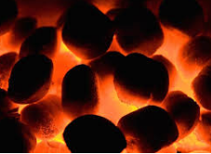
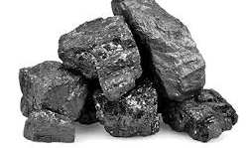
When coal burns, stored chemical energy is transferred by heating to the surroundings. The temperature of the surroundings increases. We can see this because the burnt coal glows red hot.
coal + oxygen → carbon dioxide + water
Complete the energy level diagram below by adding the products
Show the heat change for the reaction on the energy level diagram
Has the coal and oxygen gained or lost energy in this reaction?
Is this an endothermic or exothermic reaction?
Energy
coal + oxygen
Reaction progress
Notes:
Purpose: to introduce new ideas, making sure that you start from what your students already know. Create time to identify and remedy misconceptions.
Ideas for checking prior knowledge:
Spider diagram
Concept cartoons
Open questions
True or false
Draw a picture of … e.g. draw a picture to show what respiration is.
MCQ quizzes
Ideas for introducing new knowledge:
Direct instruction using the white board
Demonstration – predict, observe and explain
Video and questions

