Slide 1
Topic | Enthalpy changes and energy level diagrams | Level | GCSE (or any course for students aged 14-16)
Outcomes | To understand the terms exothermic and endothermic To be able to draw energy level diagrams for endothermic and exothermic reactions
Information for teachers | These slides take students through a series of steps to help understand energy level diagrams for exothermic and endothermic reaction. You could use these slides once students have been taught the basics. Students will initially struggle to understand why an exothermic reactions has a negative enthalpy change.
www.thescienceteacher.co.uk | resources for science teachers who like to think

Slide 2
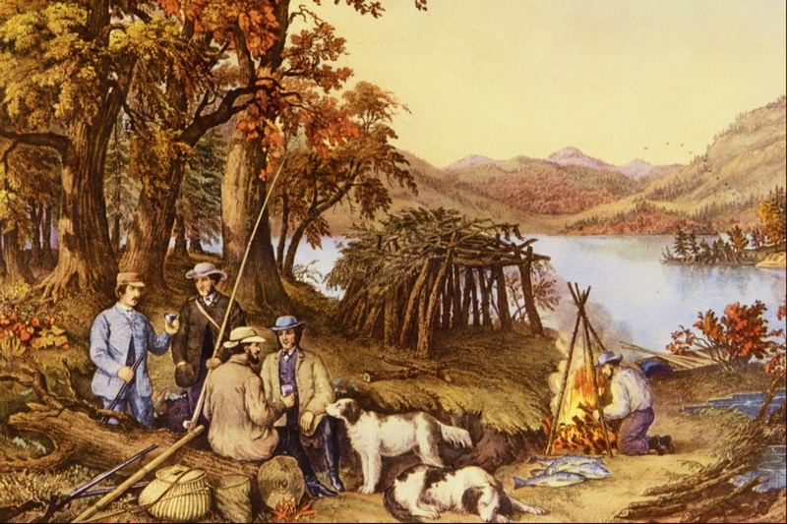
The men in this picture are being kept warm by the fire. We can use a diagram to show what energy changes are taking place when the wood burns.

Slide 3
Questions
Where are the products on this energy level diagram?
ΔH = positive or negative?
ΔT(surroundings) = positive or negative?
Energy (J)
reactants
(fuel + oxygen)
Progress of reaction

Slide 4
Temperature of surroundings would increase.
Energy (J)
reactants
(fuel + oxygen)
ΔH = negative
products (carbon dioxide + water)
Progress of reaction

Slide 5
Questions
ΔH = positive or negative?
ΔT(surroundings) = positive or negative?
Energy (J)
Reactants
Products
Progress of reaction

Slide 6
Questions
ΔH = positive or negative?
ΔT(surroundings) = positive or negative?
Energy (J)
Products
Reactants
Progress of reaction

Slide 7
Questions
ΔH = positive or negative?
ΔT(surroundings) = positive or negative?
Energy (J)
Reactants
Products
Progress of reaction

Slide 8
Questions
ΔH = positive or negative?
ΔT(surroundings) = positive or negative?
Energy (J)
Products
Reactants
Progress of reaction

Slide 9
Before the reaction could begin, the man had to light the fire with a match. Can you show this on your energy level diagram? We call the minimum energy needed to start a reaction the activation energy or E_{a}.

Slide 10
E_{a}
Energy (J)
Reactants (fuel + oxygen)
ΔH
Products (carbon dioxide + water)
Progress of reaction

Slide 11
Which colour line represents the enthalpy change?
Which colour line represents the activation energy?
Energy (J)
Progress of reaction

Slide 12
Which colour line represents the enthalpy change?
Which colour line represents the activation energy?
Energy (J)
E_{a}
Progress of reaction

Slide 13
Sketch your own energy level diagrams
A reaction with a small activation energy where ΔH is negative
An enothermic reaction with a large activation energy
The reaction between Mg and O₂
The combustion of petrol
The reaction inside an ice pack
Melting snow

Slide 14
Think deep! If a match is required to start a fire, why doesn’t the fire go out when the match finishes burning?
E_{a}
Energy (J)
reactants (fuel + oxygen)
ΔH
products (carbon dioxide + water)
Progress of reaction

